Slide 1
Counseling Services
SDC, Second Floor, Suite 2260

Slide 2
Meet the Team

Slide 3
People with mental health needs, even those who are managing their mental illness, CAN tolerate the stress of holding down a job or school work.

Slide 4
FACT

Slide 5
People with mental health problems can snap out of it if they try hard enough.

Slide 6
FICTION

Slide 7
Therapy and self-help are a waste of time. Why bother when you can just take a pill?

Slide 8
FICTION

Slide 9
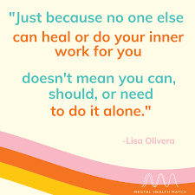
What is Counseling Services?
Collaborative approach between counselor and student
Helps student to find balance with school, work, social life
Counselors focus on concerns and offer support and encouragement
Counseling plan is person-centered and based on needs
Available to all currently enrolled students at no cost
Counseling services are private and confidential

Slide 10
Services
Triage within 24 business hours-rapid response
In person and virtual
Individual, relationship, and group counseling
Crisis Assistance
Outreach and Educational Workshops
COVID mental health care
Services provided by licensed clinicians
Psychiatrist on site Tuesdays- 2PM-5PM
(Case management)

Slide 11
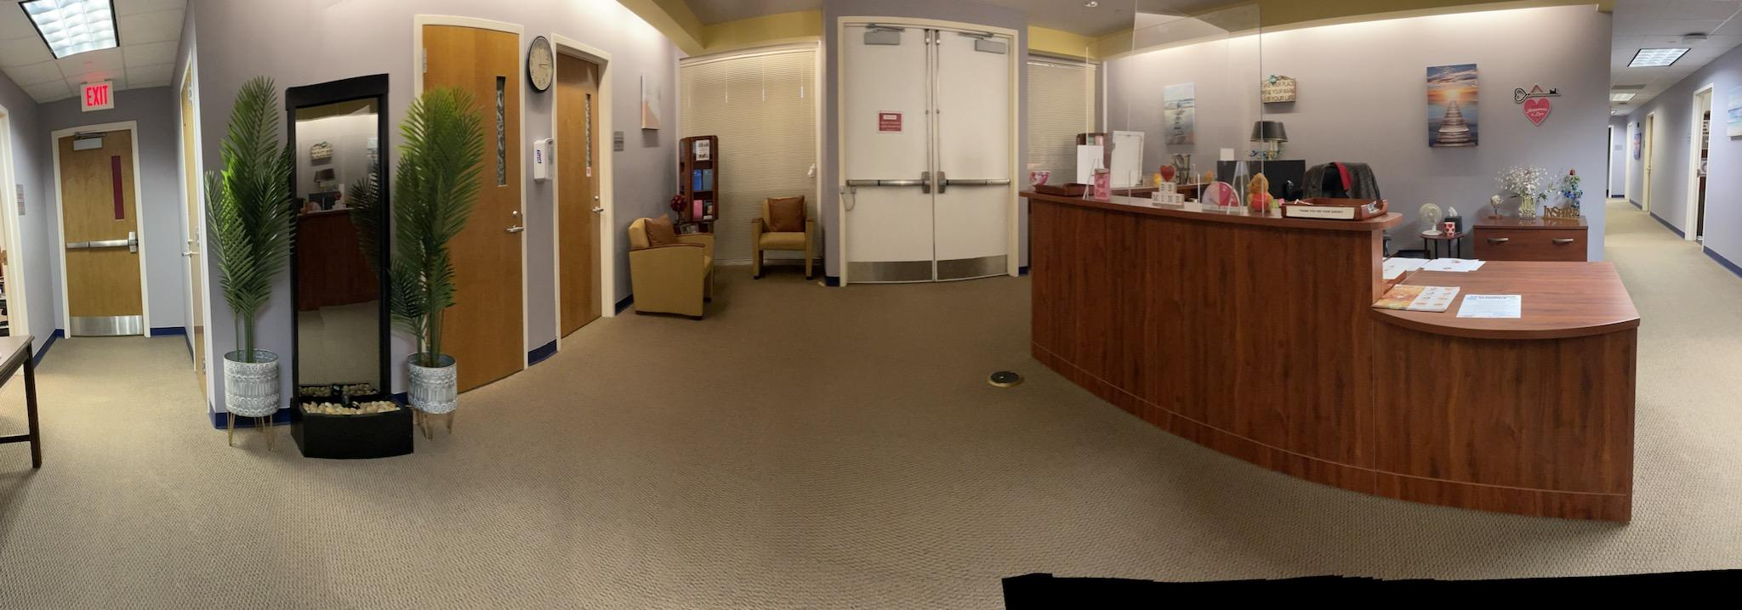
What to Expect When Visiting Counseling Services
Warm greeting at the front desk
New- quick assessment for level of triage
On-call counselor
Warm environment that caters to senses
Affirmations on the wall
Mirror waterfall

Slide 12
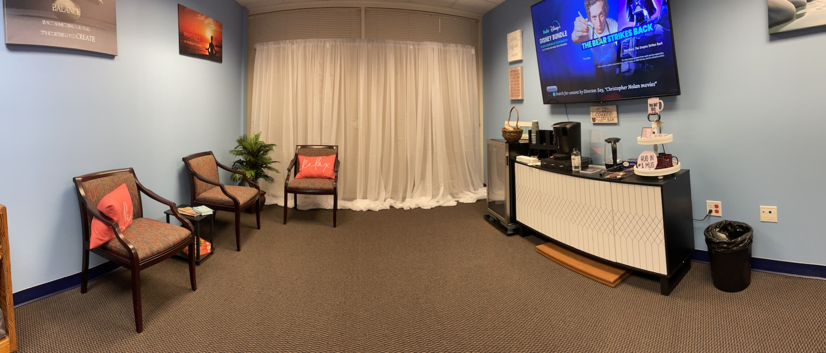
Relaxation Zone

Slide 13
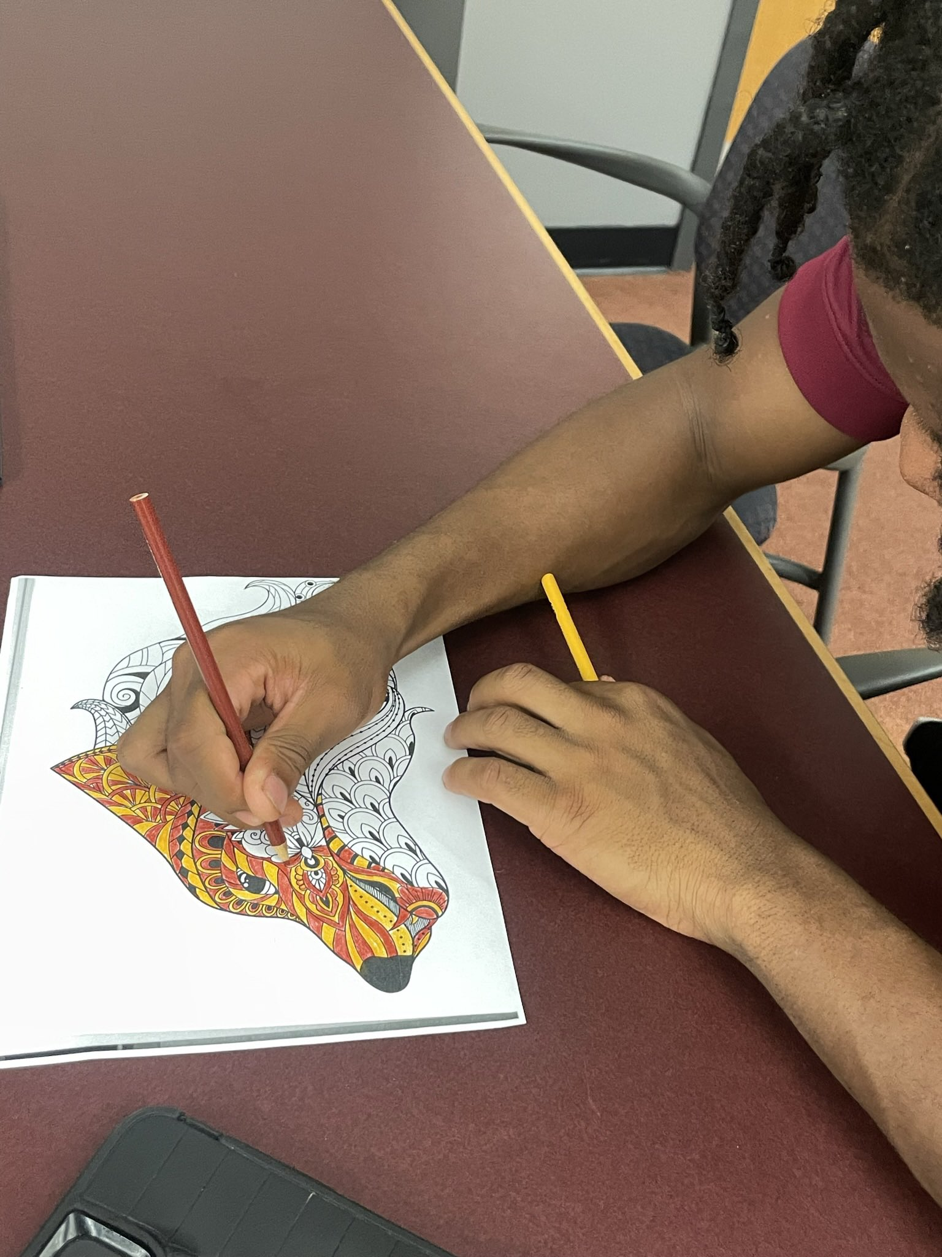
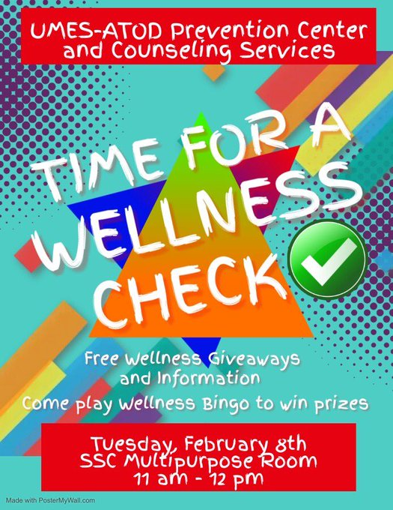
Outreach Activities

Slide 14
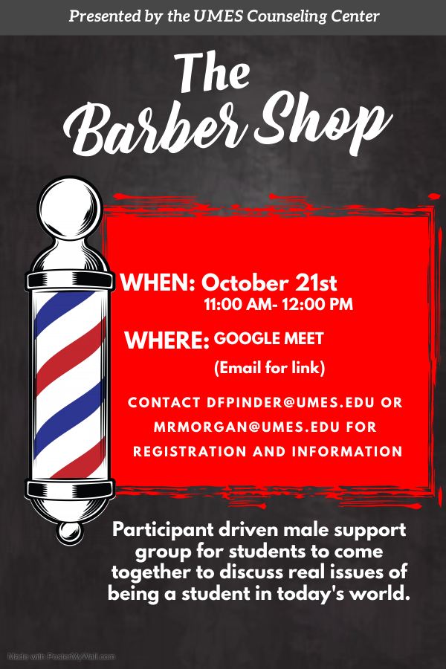
Support Groups and Workshops

Slide 15
Common Concerns of Students
Traumatic Experience
Alcohol and Substance Abuse
Family issues
Suicide Ideation
Stress Management
Sexual Assault or Harassment
Anger Management
Pandemic related grief/stress
Test anxiety
Study skills
Depression
Grief and loss issues
Sexual Identity and orientation
Relationships
Parenting and unexpected pregnancy support

Slide 16
Signs Students May Need Counseling
Marked decline in quality of work
Increased absence from class or failure to turn in work
Attention and memory difficulties
Low self-esteem
Nervousness, agitation, excessive worry
Irritability and sudden outbursts of anger, threats of harming others, aggressiveness, or nonstop talking
Abrupt or radical changes in behavior or bizarre behavior, speech, writing, or thinking
Abnormal eating or exercise behaviors
Alcohol and other drug abuse
Isolation from others
Extreme dependency on faculty, staff, or community leader
Chronic fatigue and low energy
Marked changes in personal hygiene
Prolonged depression, suggested by a sad expression, apathy, weight loss, sleep difficulties, or tearfulness
Talk of suicide, either directly or indirectly

Slide 17
Healthy Hawks (410)651-HELP

Slide 18
https://app.uwill.com/login.

Slide 19
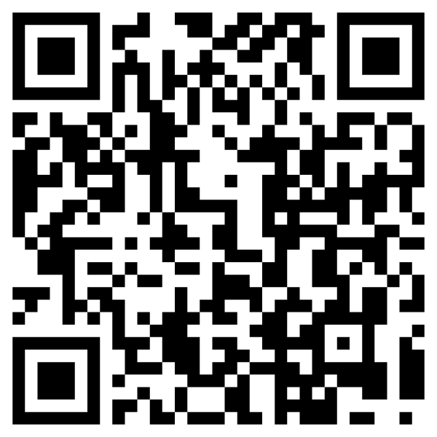
Referrals
Walk-in
Call
On-line

Slide 20
Take care of your physical & mental health.
You can’t achieve success without taking care of yourself
Maintaining your health is crucial to reaching your goals
Find balance
Hold space for yourself
Seek professional help

Slide 21
WHAT IS SELF CARE?
Self-care is about replenishing your resources without depleting someone’s else. Self-care is a means of restoring your own energy, which promotes healthy physical, spiritual, and emotional well-being.
c
c

Slide 22
A person and a battery have
a lot in common.
If you continually use them without giving them time to recharge,
they will both eventually cease to function.

Slide 23
RECHARGE
REstorE
an electric charge to (a battery or a battery-operated device)by connecting it to a device that draws from another source of electricity.
REturn
to a normal state of mind or strength after a period of physical or mental exertion.

Slide 24
* Headaches & muscle tension
SIGNS
* Trouble with sleep patterns
* Feeling overwhelmed and cynical
of burnout
*Frustrated and unfulfilled
* “Sunday night blues” before work
* Sense of apathy or over complaining
* Feeling depleted after work
* Irritability or losing your temper

Slide 25
SELF-CARE
activities
Take time to rest
Exercise/walk
Change your eating habits (reduce sugar and caffeine)
Drink lots of water
Journal
Turn off email and phone outside of work hours
Take 10-15 minutes daily to breathe
Do something fun monthly
Prayer and meditation
Go to church
Treat yo’ self
Find out what makes you happy
Surround yourself with positive people
Remove yourself from toxic situations
Set appropriate boundaries
Take vacations every 3 months

Slide 26
Take the time to write 2-5 ways you self-care.
MAKE AN APPOINTMENT
with yourself

