Slide 1
USER INPUT FOR PPE FOR PESTICIDE OPERATORS: A GLOBAL FRAMEWORK FOR DATA COLLECTION
Anugrah Shaw^{1*}, Thavy Staal², Marcelo Macedo³ Hamilton Ramos⁴, Sonja Sterman⁵
1 University of Maryland Eastern Shore, Princess Anne, MD 21853, USA
2 BASF, Limburgerhof, Germany
3 AZR, Pinhal, Brazil
4 Instituto Agronomico, Jundiaí, Brazil
5 University of Maribor, Faculty of Mechanical Engineering, Maribor, Slovenia
* ashaw@umes.edu

Slide 2
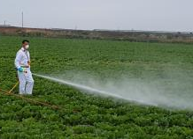
Introduction
Personal protective equipment (PPE) important for exposure reduction, especially for handheld applications.
Operator exposure studies, important to determine PPE required for risk reduction.
PPE to mitigate risk considered in the authorization of pesticide products.
The FAO Pesticide Registration Toolkit developed for regulators in countries with limited resources.

Slide 3
ICPPE-LMIC Initiative
WG 4
User-friendly Risk Assessment
and Mitigation Tool
Goal: Improving Operator Safety in LMIC
Steering Committee: Strategy and scoping
Working Groups: technical expertise and FAO/WHO observers
Outcomes:
Global database with approx. fifty studies
Operator exposure model for handheld applications
Development of risk assessment and mitigation tool to be proposed for FAO toolkit
Global Database /
Operator
Exposure
Model
Dermal Absorption
Personal
Protective
Equipment
(PPE)
WG1
WG2
WG3
Steering Committee
Steering Committee

Slide 4
PPE for Risk Mitigation
WG 4
User-friendly Risk Assessment
and Mitigation Tool
Mitigation – A bridge between risk assessment and risk management
Working Group 3 consists of a diverse group of experts
Risk assessors – operator exposure data analysis
PPE experts – PPE performance and certification
Risk managers – regulators and industry experts
Sub-groups to address specific issues, including user acceptance.
User acceptance is crucial for adoption of PPE
A global framework for efficient and consistent data collection
As grassroots approach to engage “local” experts and farmers
Coordination at the global and “local” level
Kenya – case study country for the ICPPE/LMIC initiative
Global Database /
Operator
Exposure
Model
Dermal Absorption
Personal
Protective
Equipment
(PPE)
WG1
WG2
WG3
Steering Committee

Slide 5
Kenya PPE Partnership Project
Key collaborators:
IAC, Brazil (fabric testing)
AZR, Brazil (protype manufacturing)
University of Maribor, Slovenia (functional design)
BASF team (Kenya logistical support and data collection; headquarters - planning)
Syngenta team (Kenya data collection)
Kenya Pest Control Products Board (risk mitigation and liaison with Kenya Bureau of Standards)
ICPPE/UMES, database development, planning/coordination.
This presentation focuses on User Acceptance for C1 garments
Pilot testing of focus group meeting done by BASF and Syngenta.

Slide 6
User Acceptance Framework: C1 Garments
In-person focus group meetings
Planning
1
2
2
Step
Step
Step
Online survey
Paper survey
Group Discussion
Conducted online survey
Target Group: Farmers and applicators.
Target Group: Farmers and applicators.
Feedback used to design 2 garment sketches.
Questionnaire completed by individuals prior to group discussion .
Group discussion/feedback: cost, color, garment features.
Production of 1/3 scale garment prototypes
User input will be used for production of commercial garments.

Slide 7
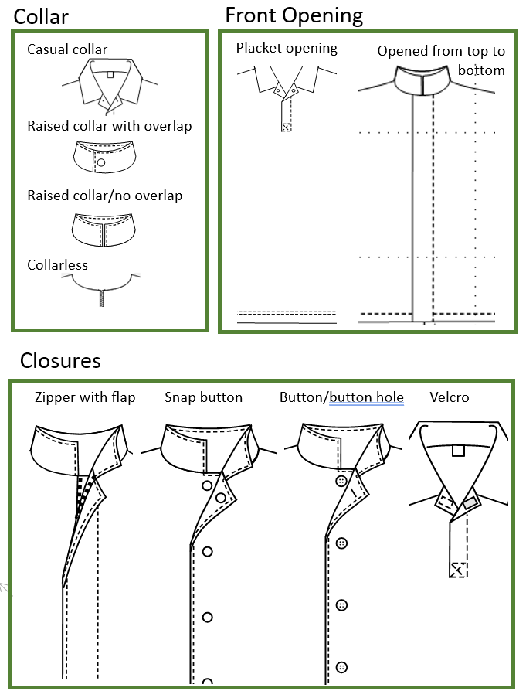
Planning for Step 1
Compiled garment types and features information
Built on prior user input surveys/interviews
Developed sketches to consistent communication
Developed online survey for Step 1

Slide 8
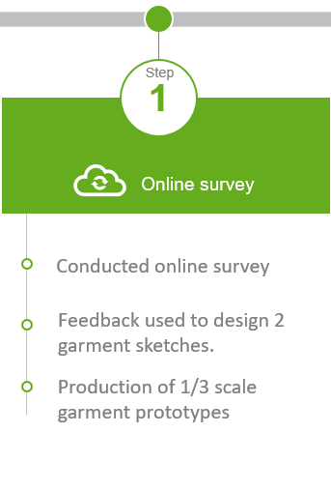
Step 1 – Input from “local” experts
Meetings with BASF and Syngenta team working with farmers/applicators in Kenya
Online survey to obtain feedback from persons working with farmers
Two garment prototypes finalized for Step 2
Questionnaire finalized for Step 2

Slide 9
Planning for Step 2 – Focus Group Meetings
Each set ~ 10-12 farmers
Meeting logistics finalized
9 sets of focus group meetings by each company
3 in different regions of the country for each crop
Approximately 10-12 participants in each meeting
Prototype (1/3rd scale) manufactured
Poster with color swatches developed
Training document prepared for Group Leaders and Notetakers.
Excel file developed for garment cost discussion
Checklist prepared
Meeting held to train Group Leaders and Notetakers
Wheat
Maize
Coffee
Wheat
Maize
Vegetables

Slide 10
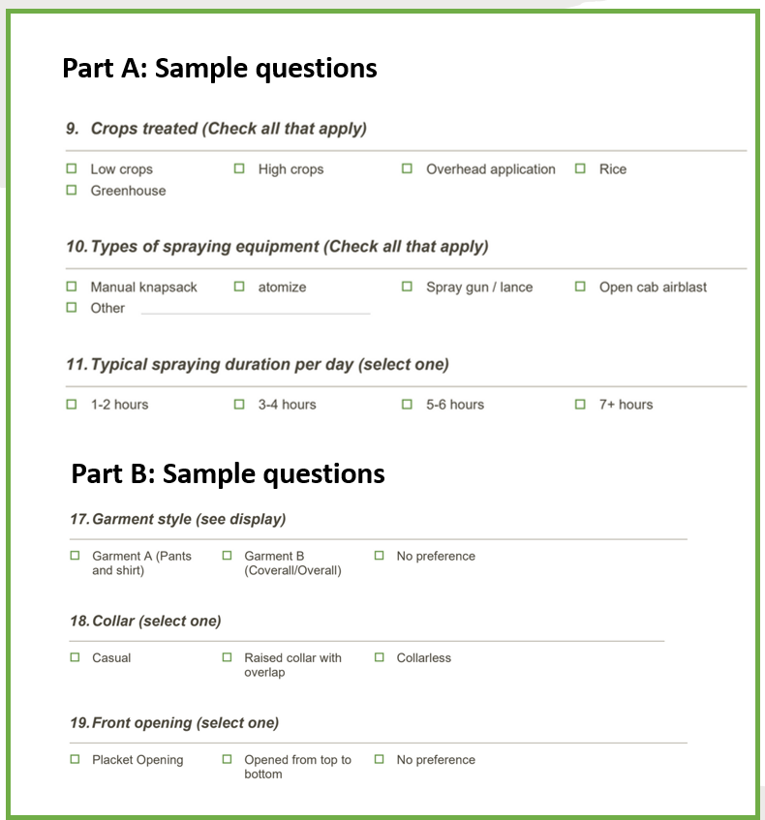
Step 2: Focus Group Meeting
Questionnaire
Overview provided by Group Leader
Consent form reviewed and signed by participant
Questionnaire completed by individual farmers/applicators
Part A: Demographic and other information
Part B: User preference
Group discussion to “design” a garment.
Completion of cost sheet and finalize garment details

Slide 11
Group Discussion – An Example of BASF meeting
Focus Group Meeting with coffee farmers in Karatina, Kenya Group Leader: Wilfred Zuma

Slide 12
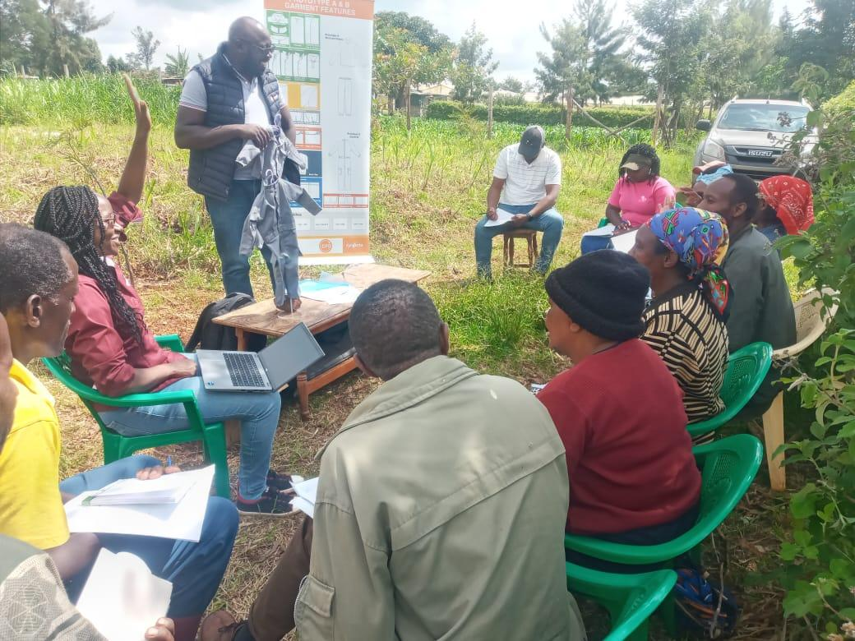
Group Discussion – An Example of Syngenta meeting
Location: Githunguri
Prototype: Coverall
Cost: Ksh. 2341
Pocket: Pant pocket: Flap with velcro
Color: Grey
Provided by:
Jenninah Mbogoh
Syngenta, Kenya

Slide 13
Acknowledgements
Special thanks to:
Project Leaders
Notetakers
Farmers and spray applicators

