Slide 1
INVESTIGATION OF ALLEGED RESEARCH MISCONDUCT
DEFINITION OF RESEARCH MISCONDUCT
Research misconduct means fabrication, falsification, or plagiarism, in proposing, performing, or reviewing research, or in reporting research results.
Fabrication is making up data or results and recording or reporting them.
Falsification is manipulating research materials, equipment, or processes, or changing or omitting data or results such that the research is not accurately represented in the research record.
Plagiarism is the appropriation of another person's ideas, processes, results, or words without giving appropriate credit.
Research misconduct does not include honest error or differences of opinion. '(§ 93.103, 42 CFR Part 93).

Slide 2
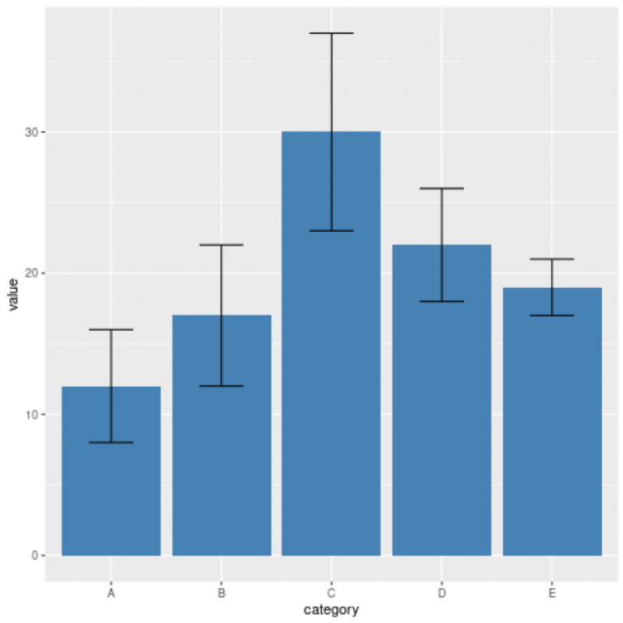
The Importance of Statistics
https://www.statology.org/error-bars-in-r/

Slide 3
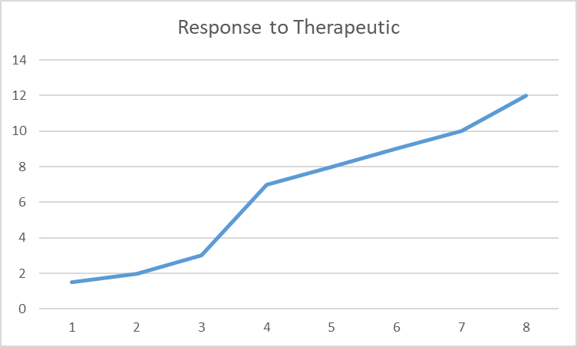
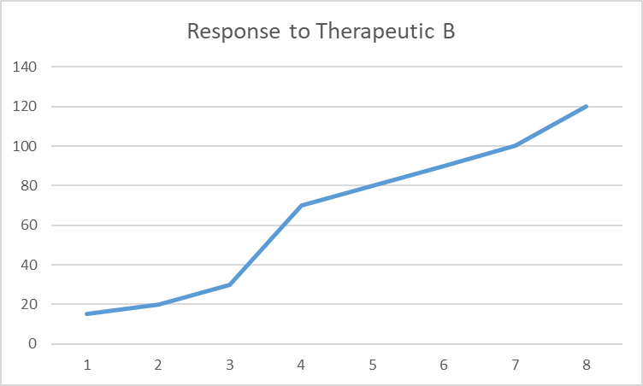
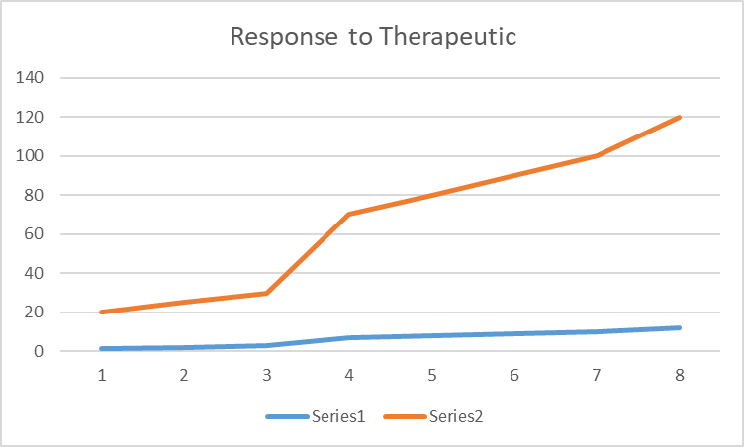
Hiding data, results, or information using inappropriate scales, magnification and representation in charts, graphs and other forms of representation
A

Slide 4
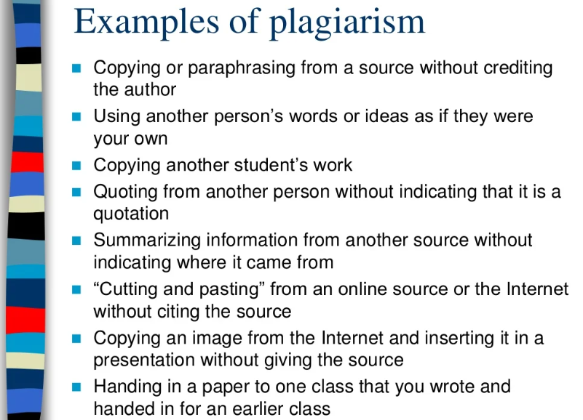
https://www.slideshare.net/johndmoore1/avoiding-plagiarism-32917393

Slide 5
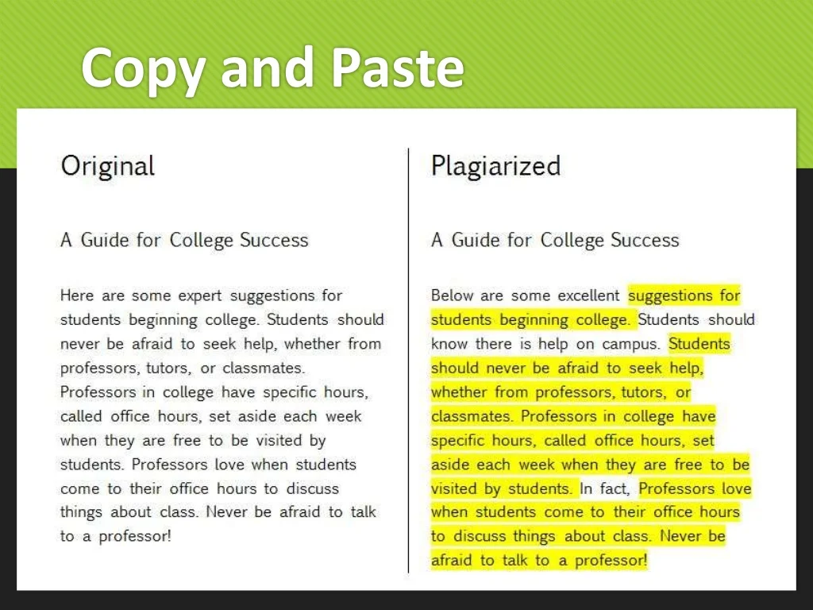
https://libguides.aum.edu/academic_honesty/understanding_plagiarism

Slide 6
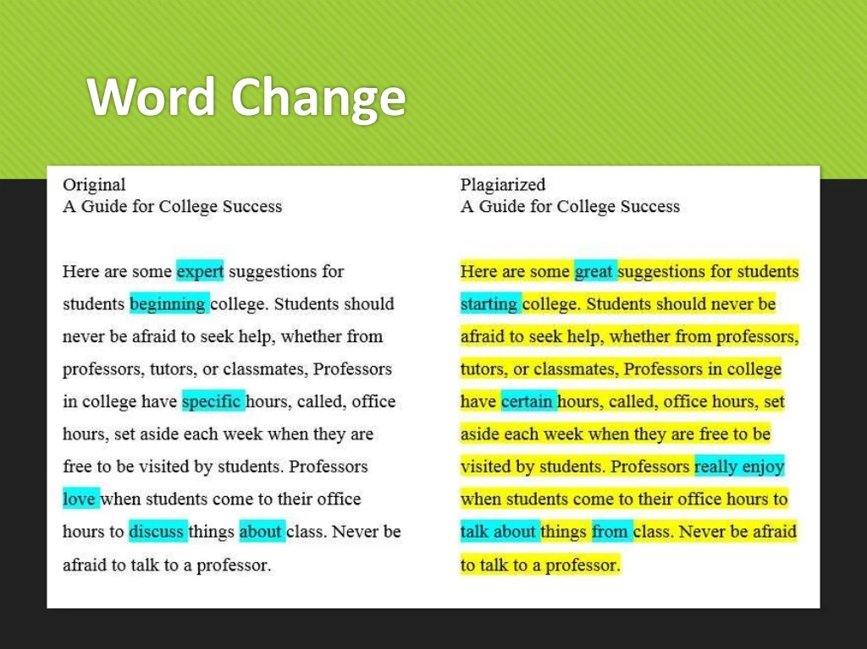
https://libguides.aum.edu/academic_honesty/understanding_plagiarism

Slide 7
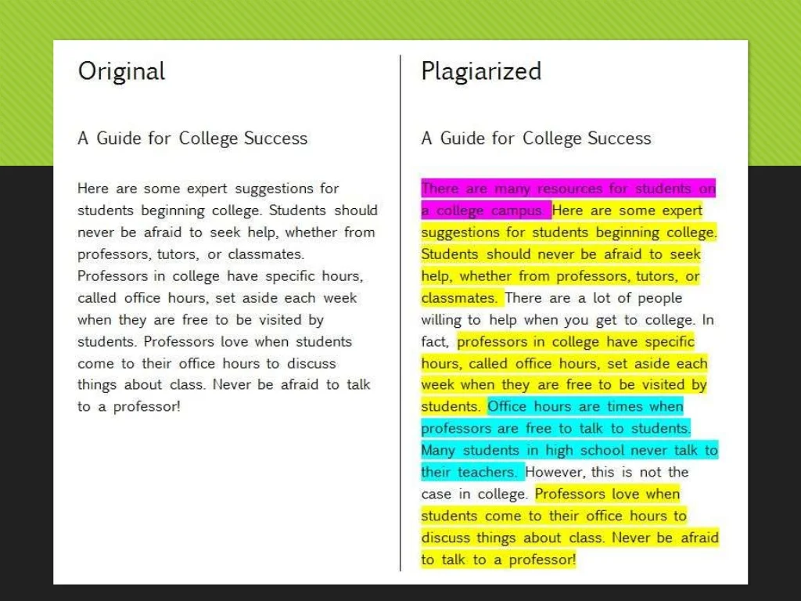
https://libguides.aum.edu/academic_honesty/understanding_plagiarism

Slide 8
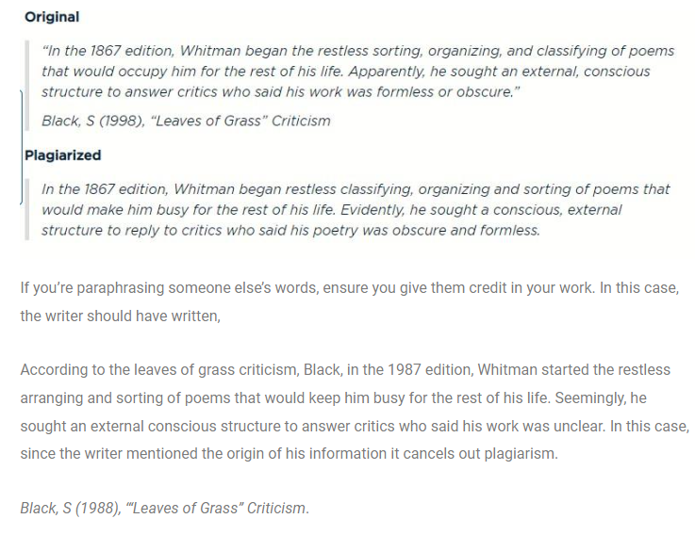
Paraphrasing Plagiarism
https://thebrightwriters.net/types-of-plagiarism-with-examples-shown/

Slide 9
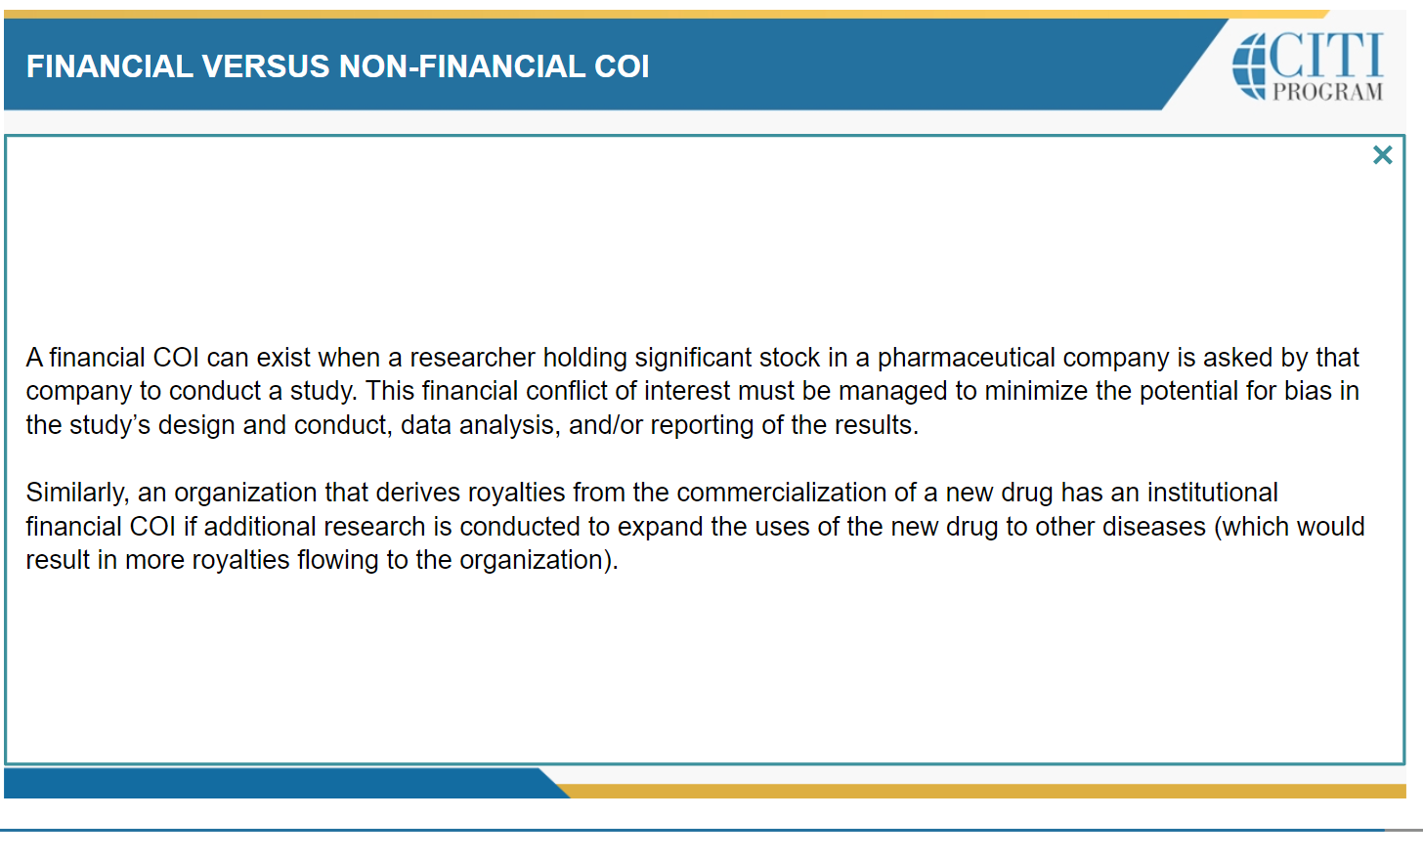

Slide 10
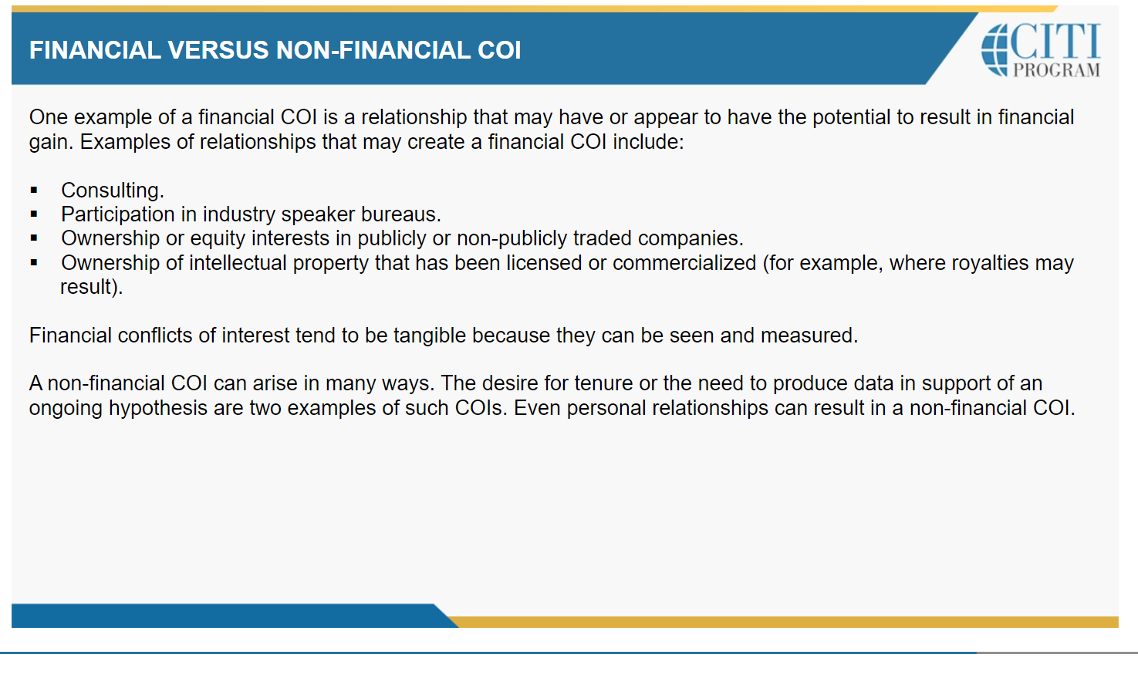

Slide 11
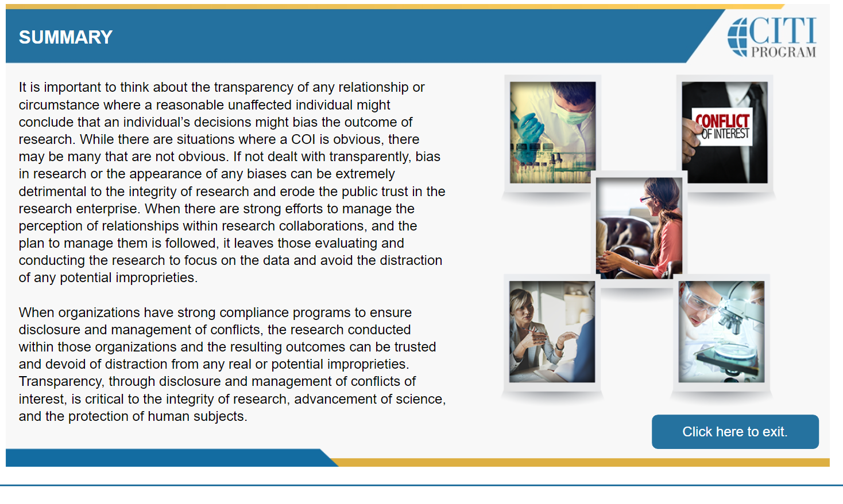

Slide 16
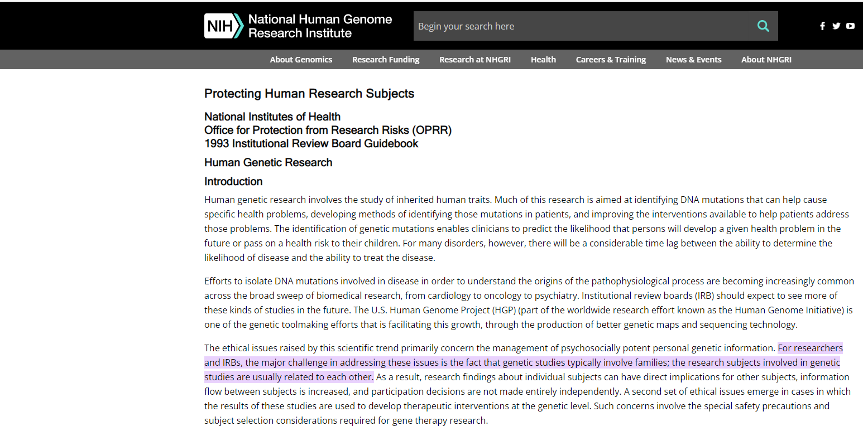

Slide 17
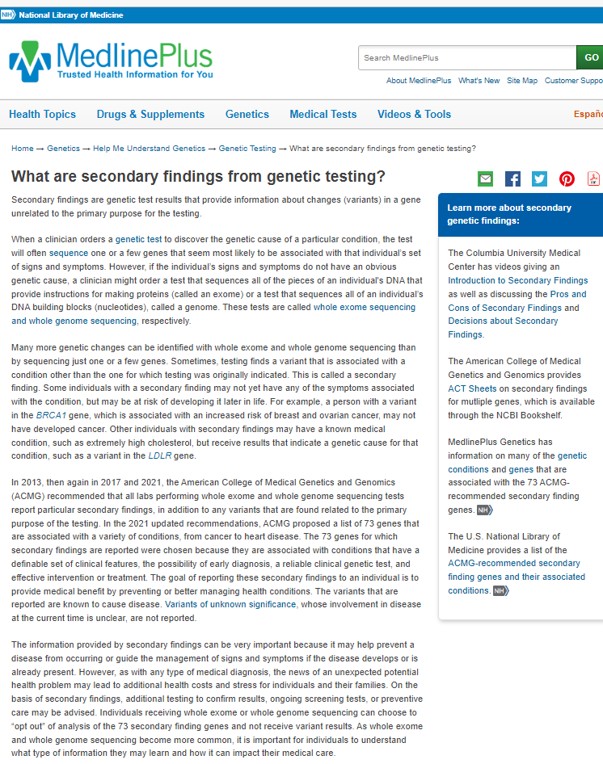
A secondary genomic finding refers to a genomic variant, found through the analysis of a person’s genome, that is of potential medical value yet is unrelated to the initial reason for examining the person’s genome.
https://www.genome.gov/genetics-glossary/Secondary-Genomic-Finding#:~:text=A%20secondary%20genomic%20finding%20refers%20to%20a%20genomic,the%20initial%20reason%20for%20examining%20the%20person%E2%80%99s%20genome.
https://www.ncbi.nlm.nih.gov/pmc/articles/PMC4800041/pdf/main.pdf
https://medlineplus.gov/genetics/understanding/testing/secondaryfindings/

