Slide 1


Counseling Services
SDC, Second Floor, Suite 2260

Slide 2

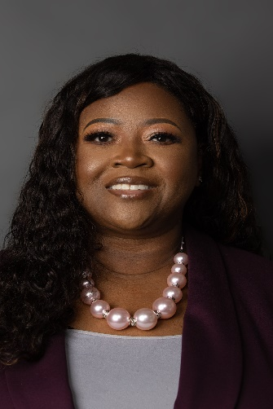
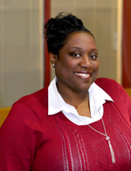
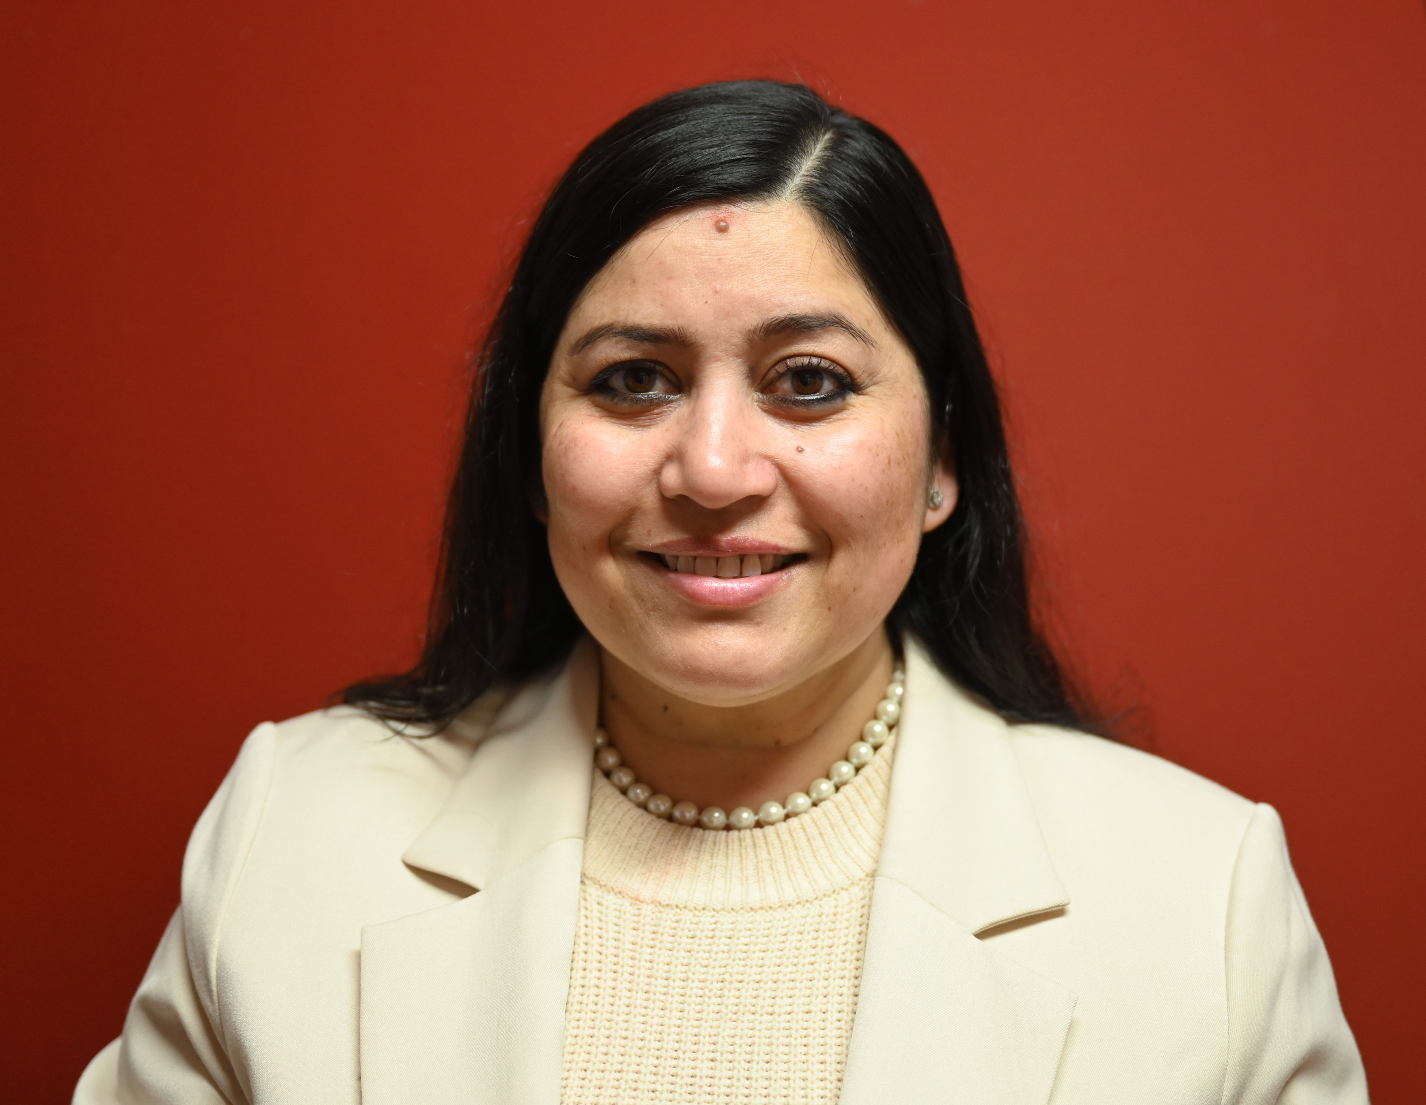
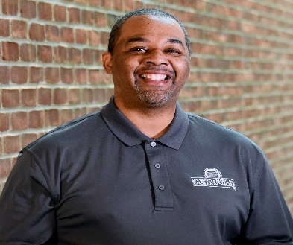
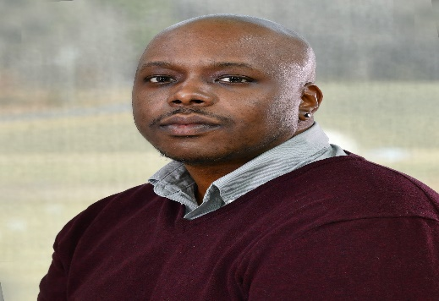

Meet the Team

Slide 3
What is Counseling Services?
Collaborative approach between counselor and student
Helps student to find balance with school, work, social life
Counselors focus on concerns and offer support and encouragement
Counseling plan is person-centered and based on needs
Available to all currently enrolled students at no cost
Counseling services are private and confidential

Slide 4

What’s discussed in counseling….
“As many as 75% of students who struggle with depression and anxiety are reluctant to seek help. This increases the risk of harmful outcomes, such as dropping out of college, poor academic performance, suicide and substance abuse (Mayo Clinic) .”

Slide 5

Common Concerns of Students
Test anxiety
Study skills
Depression
Grief and loss issues
Sexual Identity and orientation
Relationships
Parenting and unexpected pregnancy support
Traumatic Experience
Alcohol and Substance Abuse
Family issues
Suicide Ideation
Stress Management
Sexual Assault or Harassment
Anger Management
Pandemic related grief/stress

Slide 6

Services
Triage within 24 business hours-rapid response
In person and virtual
Individual and relationship counseling
Crisis Assistance
Outreach and Educational Workshops
Services provided by licensed clinicians
Psychiatrist on site Tuesdays- 2 PM-5 PM
Case Management

Slide 7
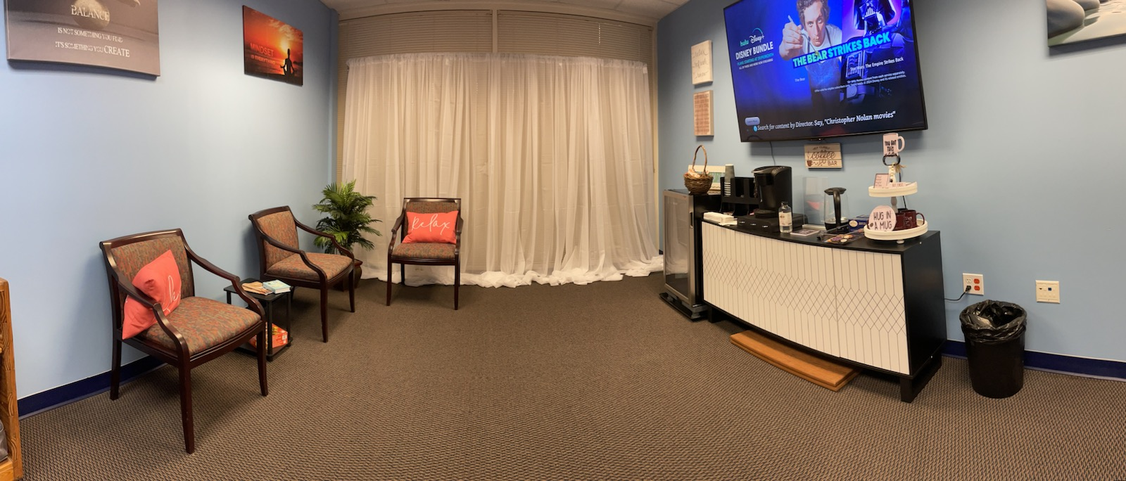
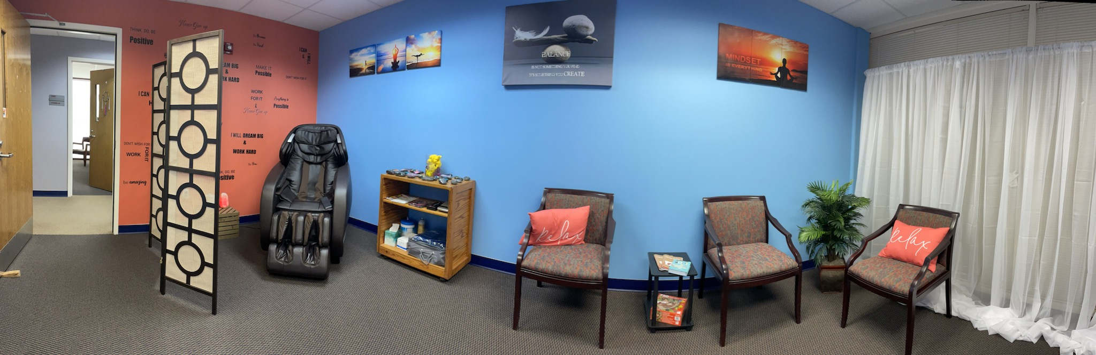
Relaxation Zone

Slide 8
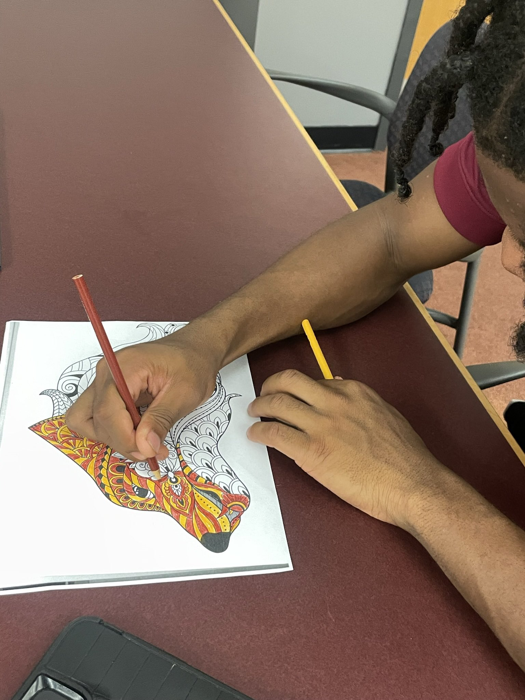
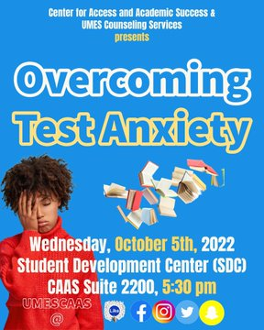
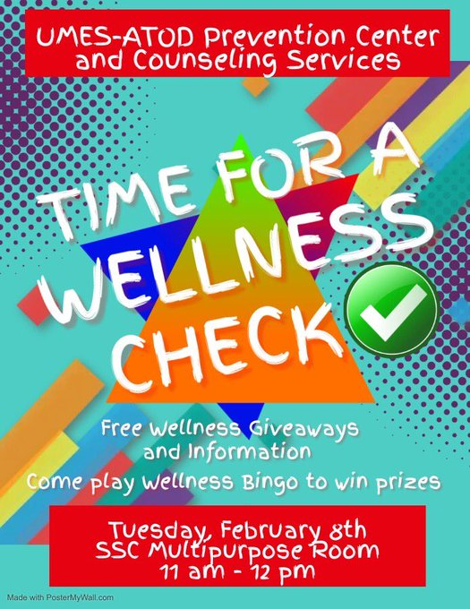
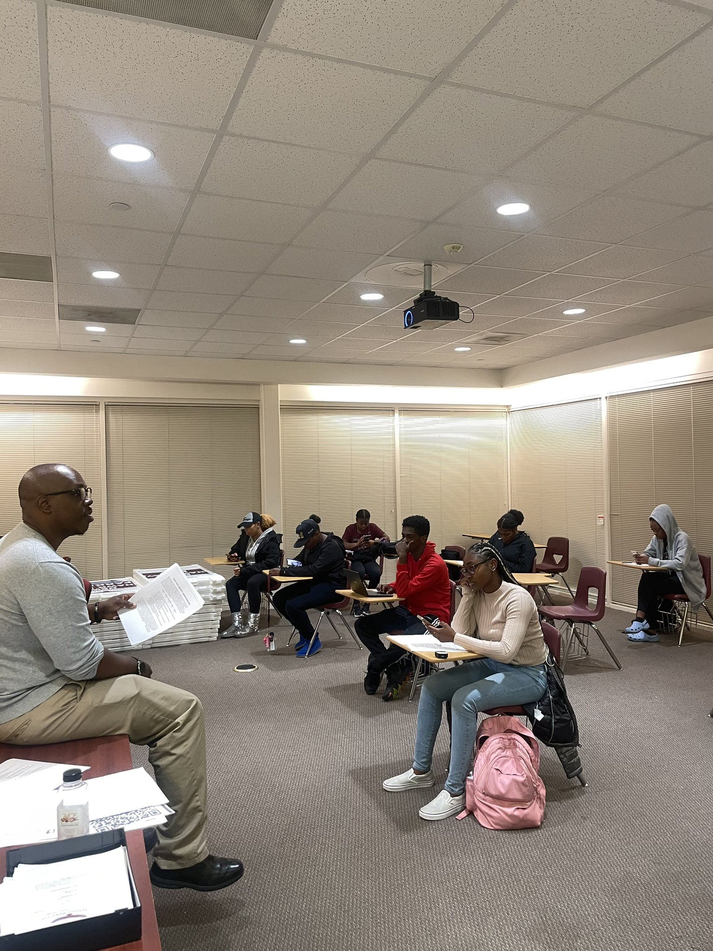
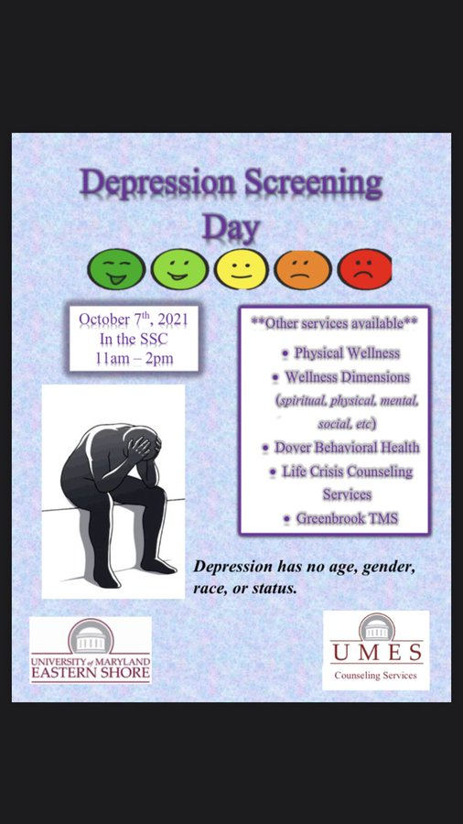
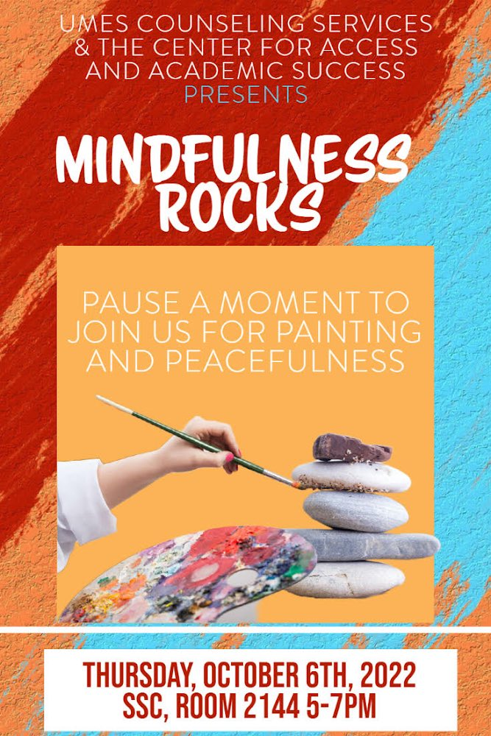

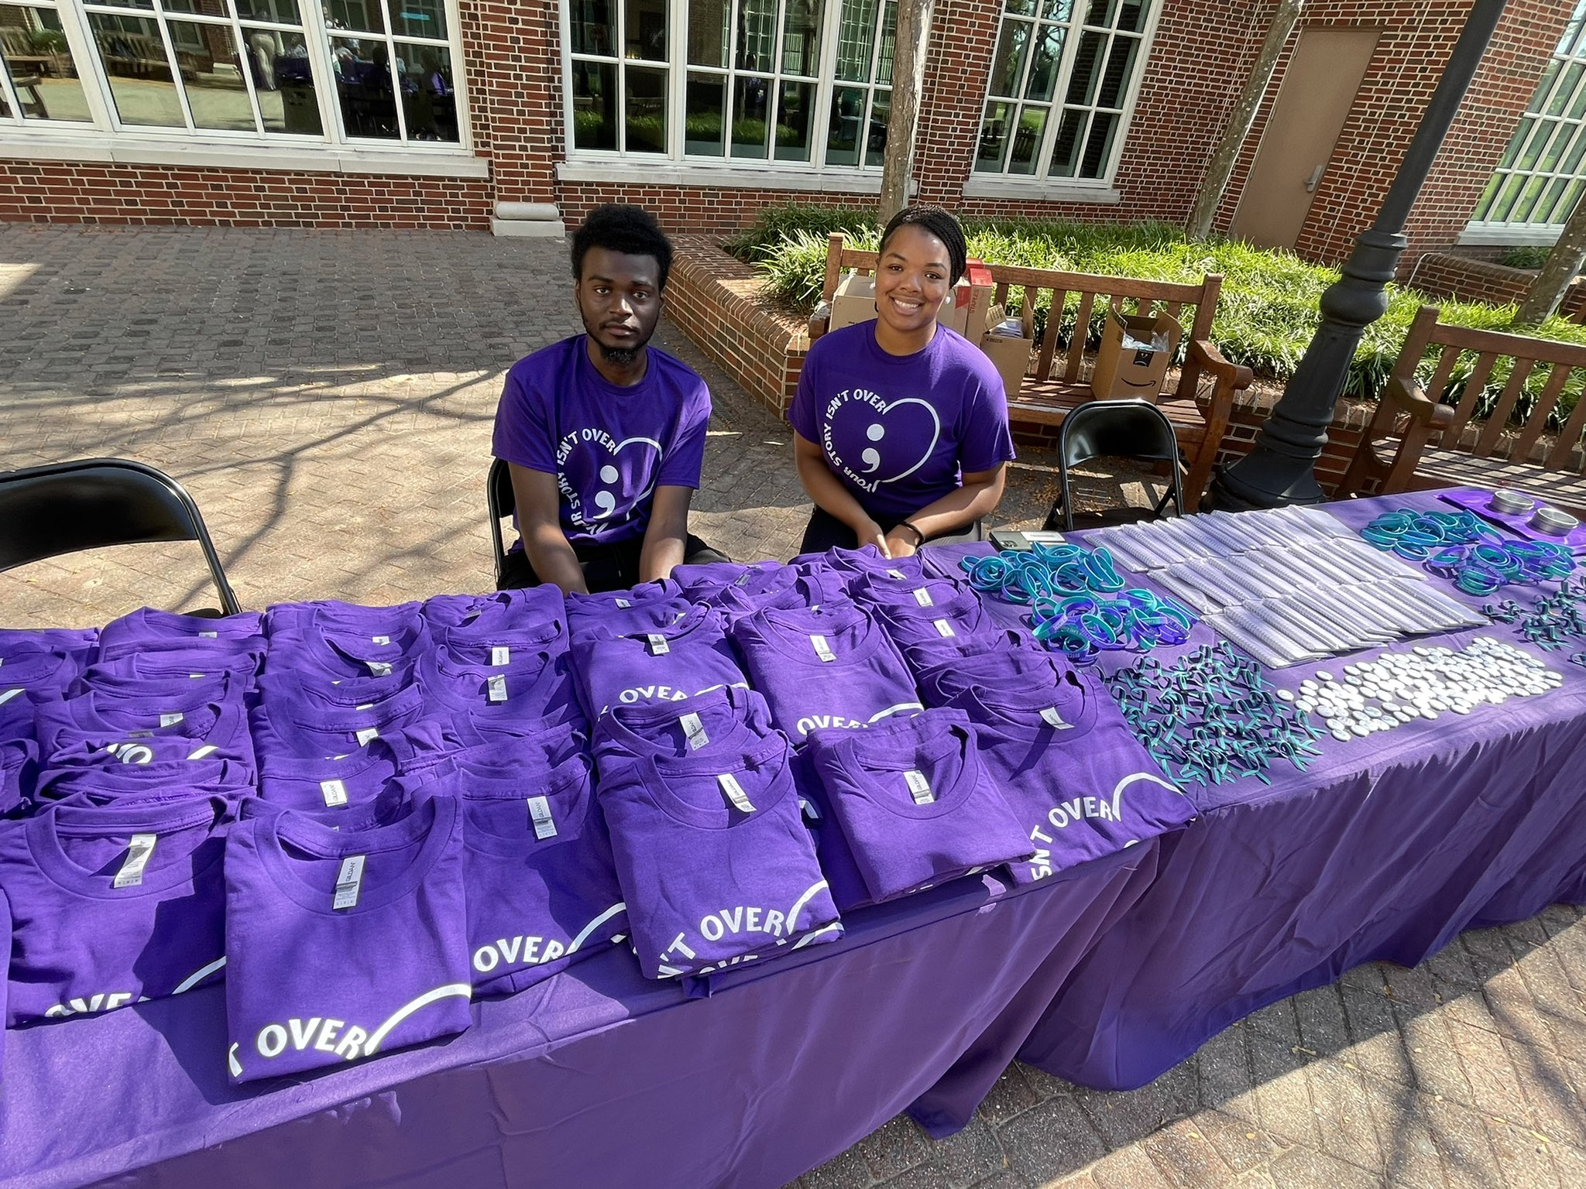
Outreach Activities

Slide 9
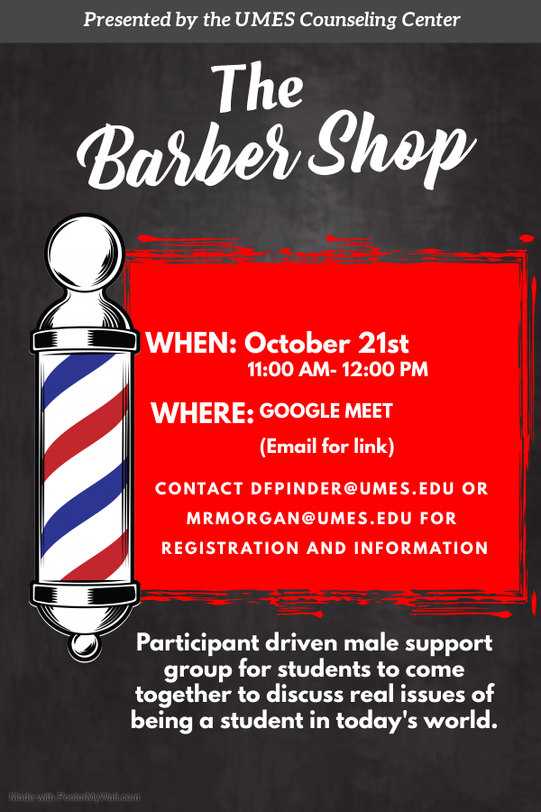
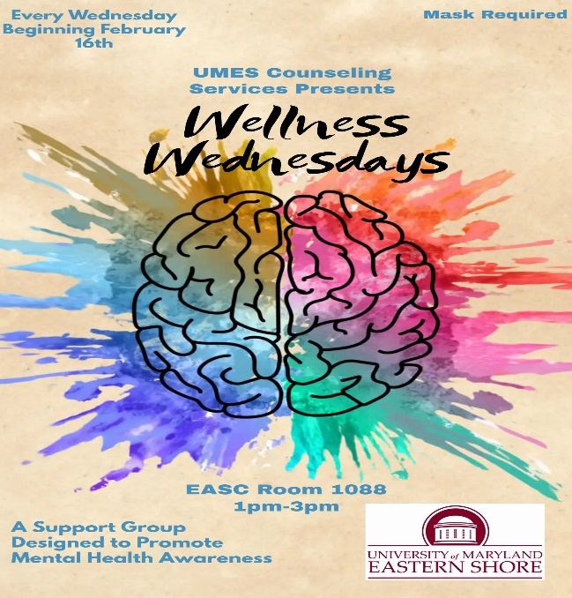
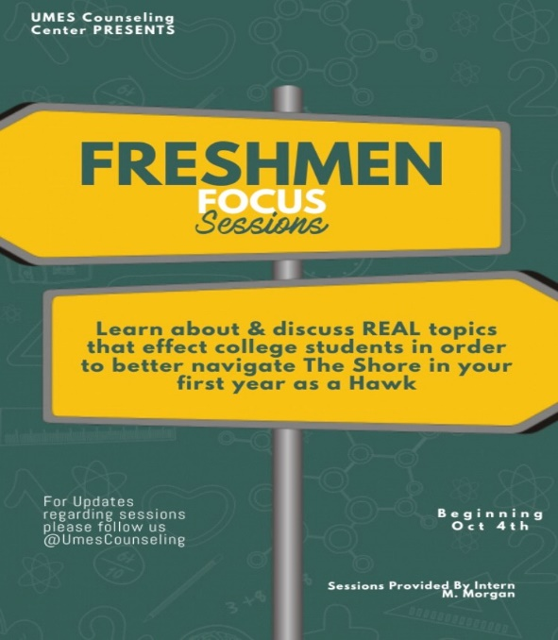
Support Groups and Workshops

Slide 10
How You Can Help
Be aware of the signs and symptoms of a mental health crisis.
Encourage others to seek help when needed.
Call UMES Counseling Services (410-651-6449)
or fill out an electronic referral form.

Slide 11
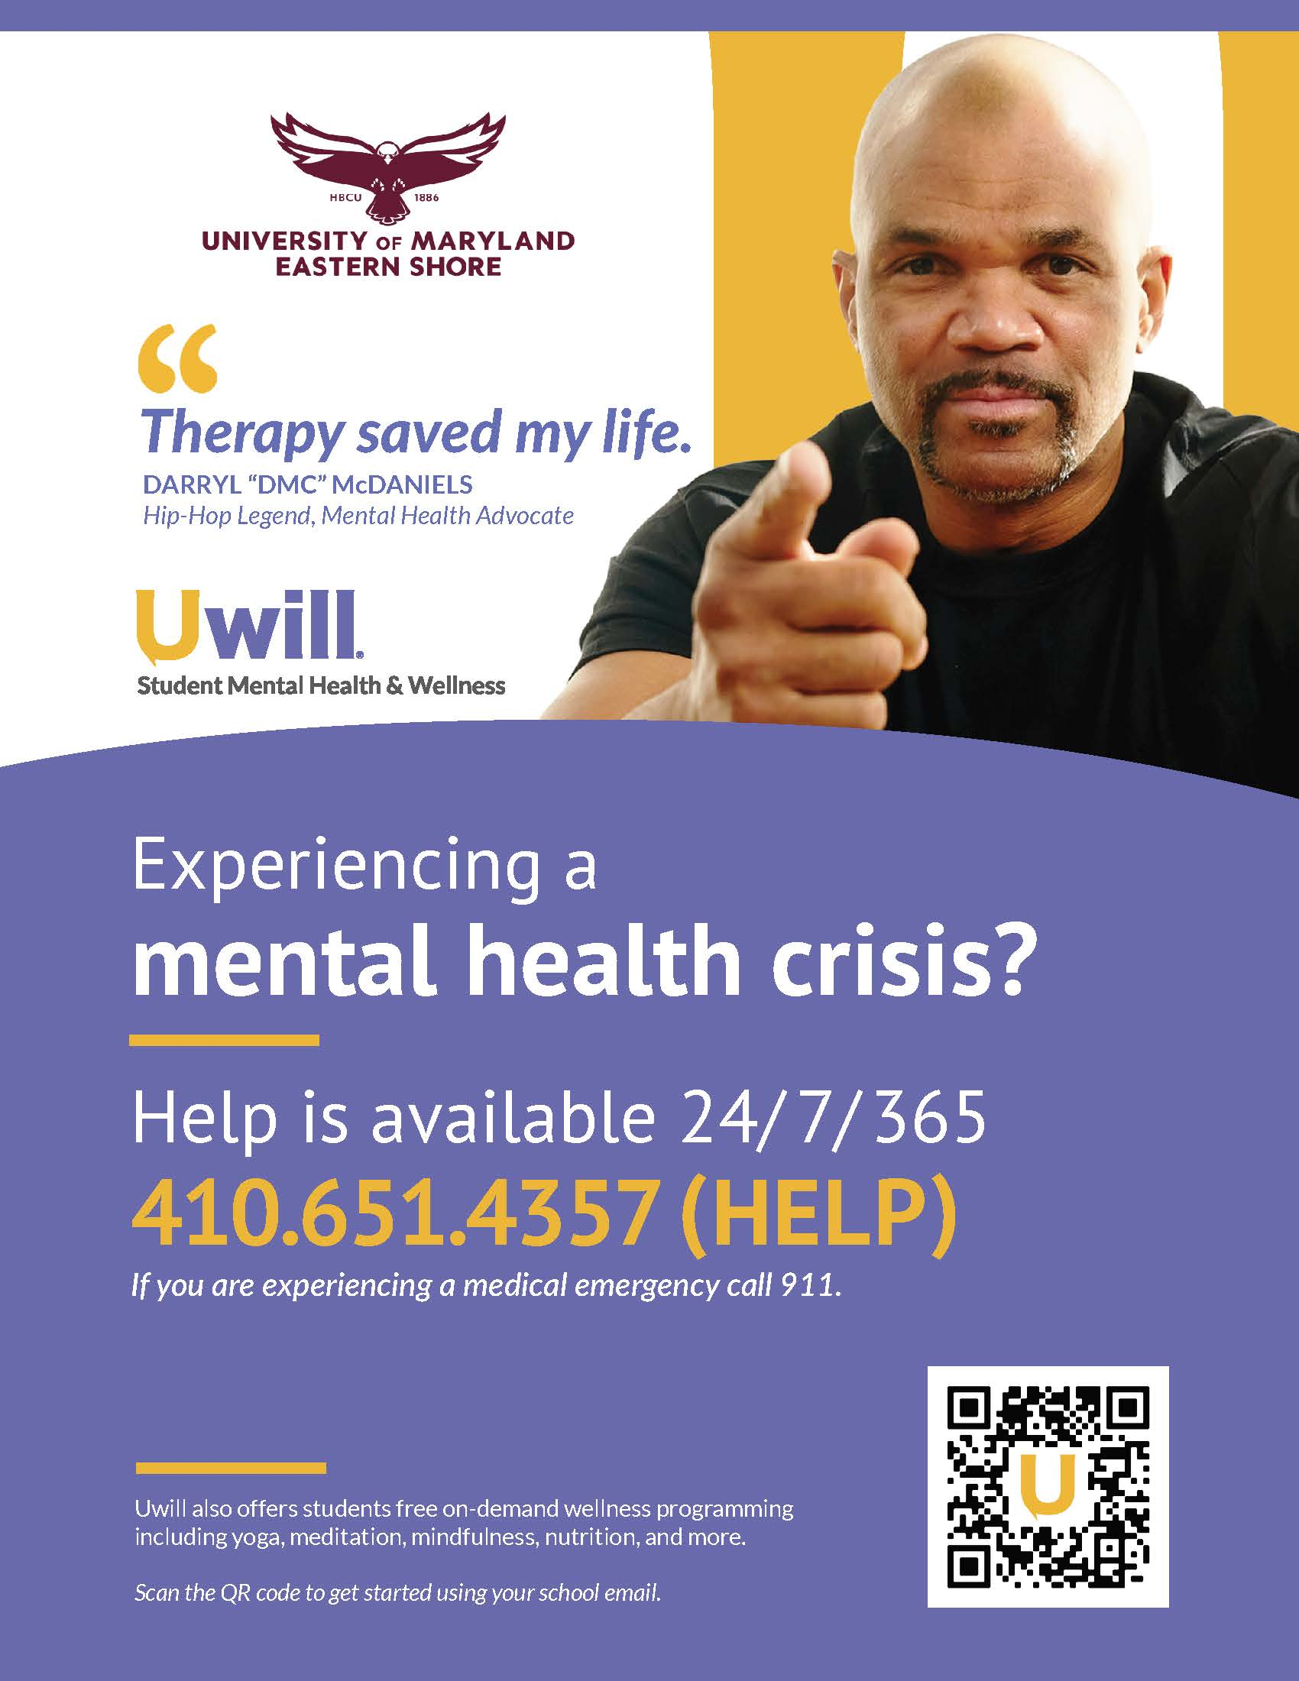
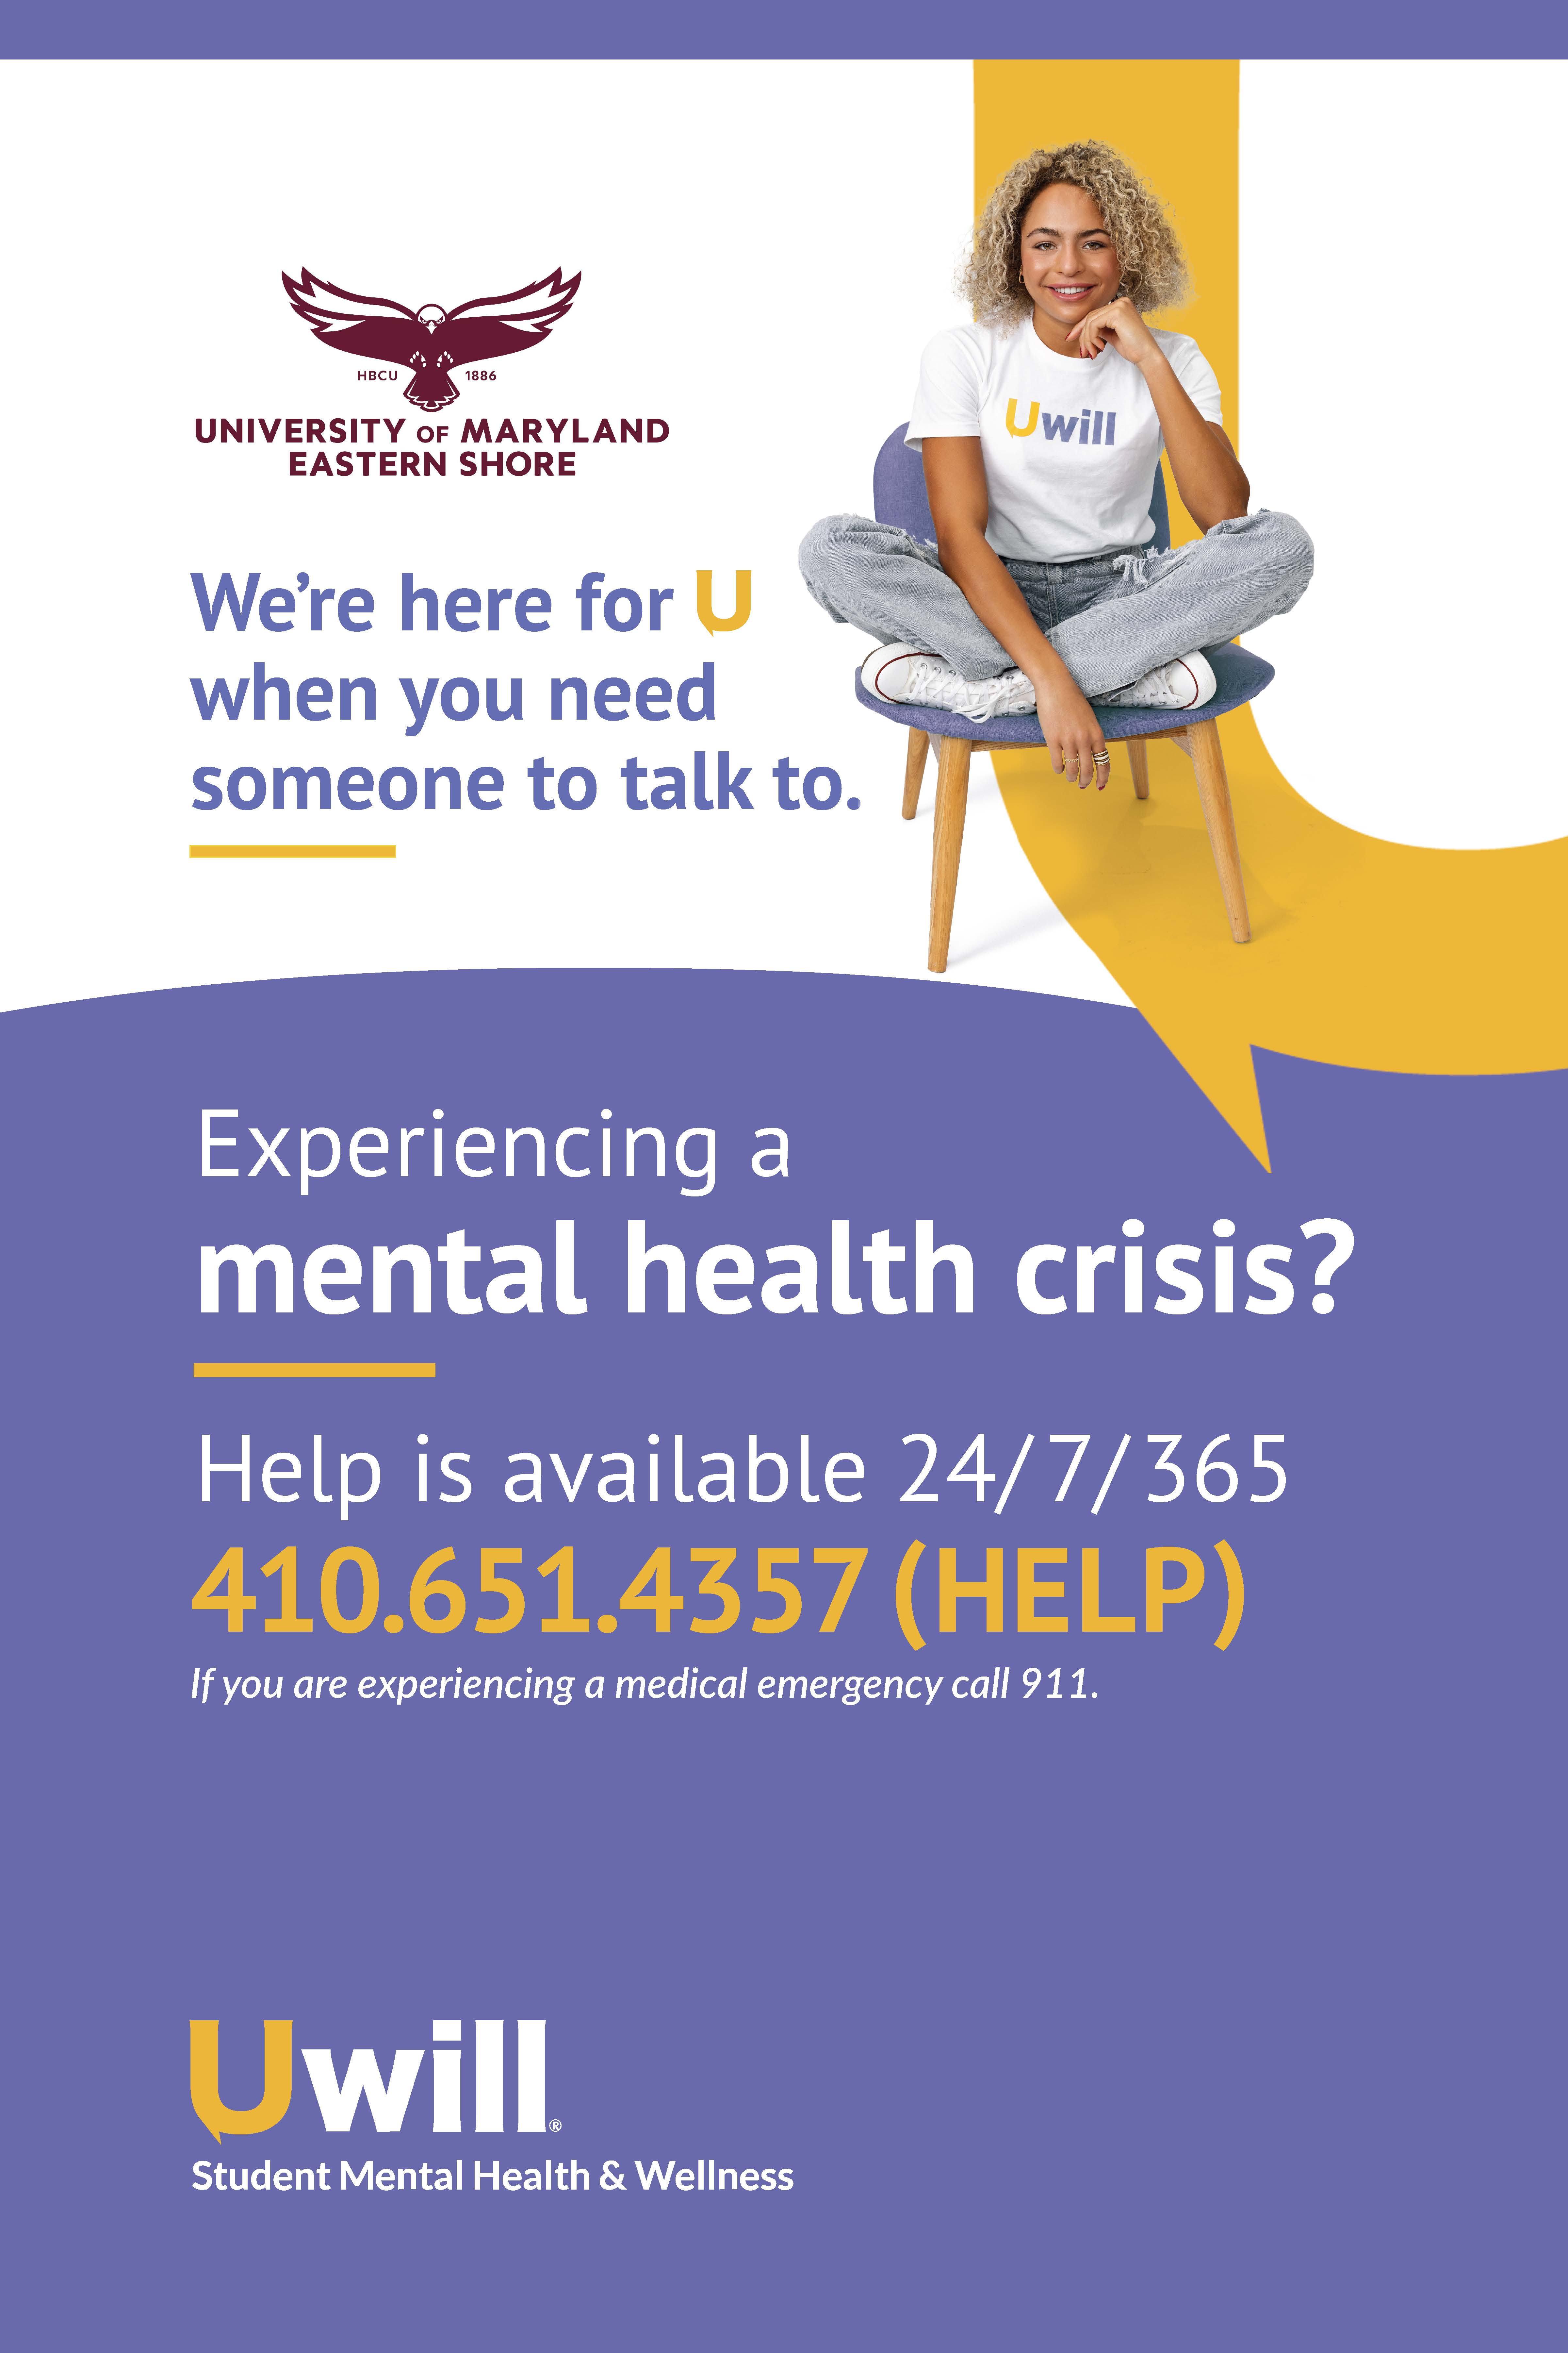
https://app.uwill.com/login.

Slide 12
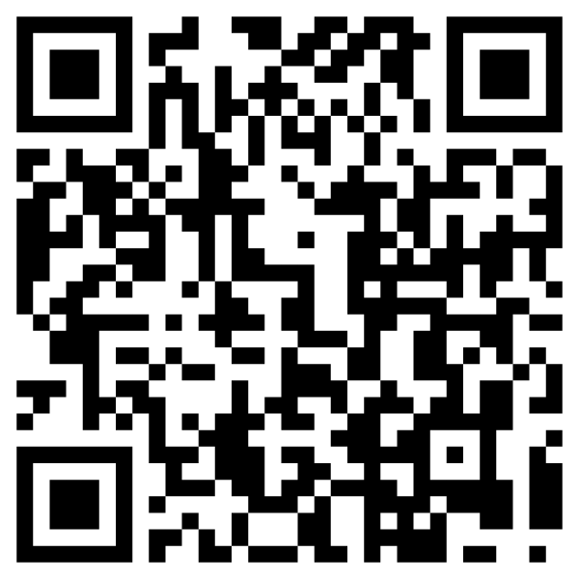
Referrals
Walk-in
Call
On-line

Slide 13


