Slide 1


Student Accessibility Services

Slide 2

The Americans with Disabilities Act (ADA)
ADA states that:
Individuals with disabilities are protected from discrimination and should be provided equal access to employment opportunities, to purchase goods and services, and to participate in state and local government programs and services.
Qualified Students with Disabilities are those who are able to meet the academic and technical standards for admission and can fully participate in the programs, services and activities offered by the University, either with or without the use of any reasonable accommodations.

Slide 3
The Americans with Disabilities Act (ADA)
The ADA National Network identifies breathing, walking, talking, hearing, seeing, sleeping, caring for one’s self, performing manual tasks as major life activities. Major life activities also now include reading, writing, concentrating, and thinking. (ADAAA § 12102(2)(A); 29 C.F.R. § 1630.2(i)(1)(i))
“The operation of major bodily functions” such as the immune, endocrine, hemic, lymphatic, and reproductive systems are now a type of major life activity to be considered. (ADAAA § 12102(2)(B); 29 C.F.R. § 1630.2(i)(1)(ii), 2011; Grossman, 2014, p. 9)

Slide 4
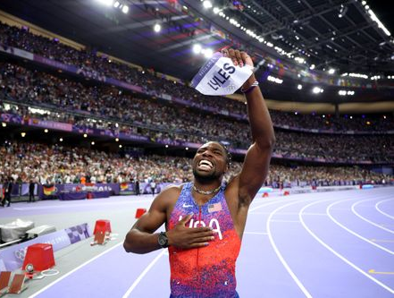
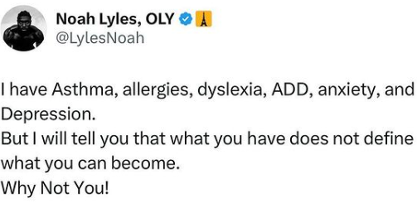
Individuals with Disabilities

Slide 5
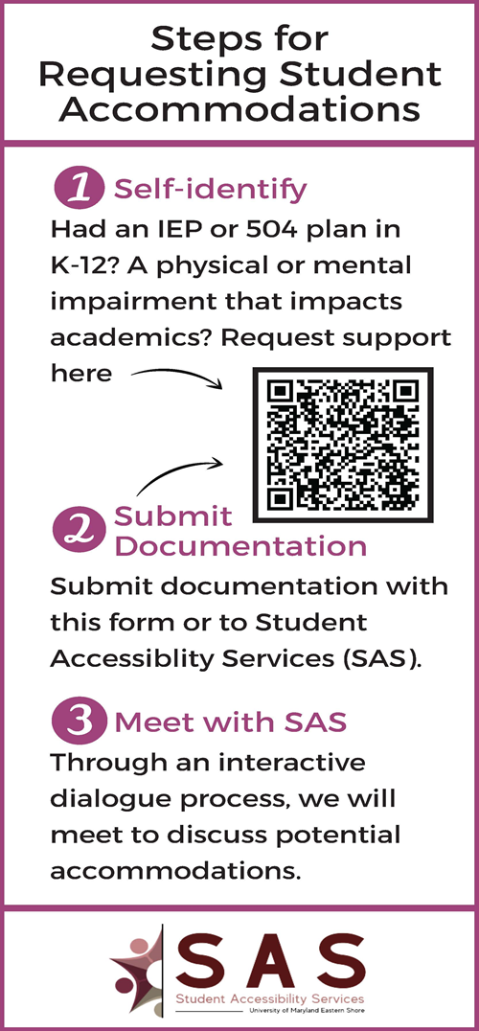
How to Request Accommodations
Self-identify by submitting a Request for Accommodations form
https://umes-accommodate.symplicity.com/public_accommodation/
Gather and submit all relevant medical or educational documentation.
Meet with SAS to engage in an interactive dialogue about your needs and potential accommodations to meet those needs.

Slide 6
Temporary Accommodations
SAS also works with students who experience temporary disabilities. Some examples:
Concussions
Car accidents
Surgeries
Broken bones
Mental Health related hospitalizations

Slide 7
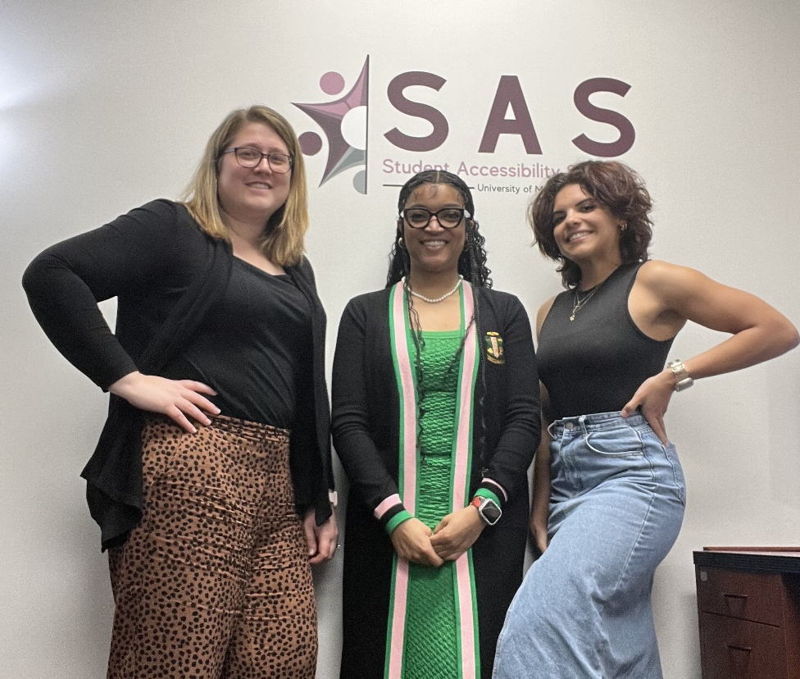
Student Accessibility Services Staff
Jessica Chittams
Director
Email: jbchittams@umes.edu
Phone: (410)651-6135
Shelita Allen
Coordinator
Email: ssallen@umes.edu
Phone: (410) 651-6135
Camilla Flagg
Specialist
Email: crflagg@umes.edu
Phone: (410) 651-6135

Slide 8
Talk to us
Instagram & Twitter: @UMESequity
Facebook: UMES Office of Institutional Equity and Compliance
Website: umes.edu/oie
Stop by: Early Childhood Research Center, Suite 1129
Call: (410) 651-6135
Email: ada@umes.edu

