Slide 1
Writing CFAs/CFPs and Creating Posters
Dr. Kelsie Endicott

Slide 2
Agenda
Upcoming events
Discuss strategies for writing CFAs/CFPs
Discuss strategies for creating poster presentations
Open workshop

Slide 3
Upcoming Events
Volunteer for the Research Symposium by Friday, March 1^{st.}
Attend the GWC’s workshop on Navigating a Career in Higher Education on Wednesday, March 6th at 6 pm.
Attend the GWC’s drop-in writing group on Saturday, March 9th from 9 am-noon.
Submit your abstracts to the Research Symposium by Friday, March 15^{th.}
Attend the Research Symposium on Thursday, April 18th.

Slide 4
Call for Proposals (CFP)/Call for Abstracts (CFA)
Phase 1: Closely read the CFP/CFA!
Re-read as often as you need to.
Highlight and take notes.
Pay attention to the language (and mirror it in your abstract proposal).

Slide 5
Strategy 1: Read the Title
Example:
Sustainable Horizons: Exploring Pathways for Knowledge Transfer through Multidimensional Research
What is the title saying? What is theme? Put it in your own words if you have to.

Slide 6
Phase 1: Carefully Read the Call
The theme of this year’s research symposium asks you to consider what it means to be sustainable. Sustainability is indexical by definition, but is most simply defined as, the quality of being able to continue over a period of time. Importantly, the pursuit of sustainability differs from that of maintenance. Oftentimes, we find that instead of living our lives in such a way as to be considered sustainable, our goal is, in fact, more short-sighted and directed at maintaining our status quo rather than aiming for the long-term goal of sustainability. To be sustainable implies our willingness to seek introspection and the courage to make necessary changes to improve our lives.
What to address as you write your draft CFP/CFA (aka the prompt)
Definition of sustainability

Slide 7
Phase 1: Carefully Read the Call
Sustainability requires us to explore paths less-traveled, or possibly, to create them. Sustainability also can also require an expansion of our work, networks, practices, attitudes, and processes, and is therefore, collaborative and multidimensional in nature. In contrast, perhaps sustainability involves a pruning of some or all of these things—a chance for us to let go of the excess or baggage that is holding us back from reaching our potential. Nevertheless, the effort to achieve sustainability requires multidimensionality, both in our approaches and in our work. It was in this spirit that we developed this year’s primary thematic question: In what ways is your research sustainable?
Operationalizing sustainability—look at the language. Mirror this in your abstract.
The prompt again, but worded as a question.

Slide 8
Phase 2: Planning for the Abstract/Proposal
Adhere to the word count.
Identify how to best represent your work (oral presentation, poster, 3MT). You may need to justify why you choose this presentation style.
Gather any relevant quotes/citations to reference to support the significance of your work.
Draw on your prior experiences with writing abstracts/proposals. What worked?
Review abstracts of your favorite model texts and notice why they are successful.

Slide 9
Phase 3: Begin Writing/Drafting
Begin writing!
As you write, remember to:
address the call
identify your presentation type
write an IMRAD-style abstract (Introduction, Methods, Research and Discussion—in our case, this will be the results/findings and significance)
use the language of the prompt in your abstract

Slide 10
Phase 4: Revision
Proofread (aloud)
Have someone else read it (GWC)
Correct submittable format
Include your name

Slide 11
Let’s Review a Sample Abstract

Slide 12
Strategies for Creating a Poster
Identify the poster size (this information is usually on the submission page) and how it will be displayed.
Once you know the size, you can look for free templates online (this is the website I use: https://www.posterpresentations.com/free-poster-templates.html )
Research posters usually contain IMRAD information.
All content should be necessary and/or significant.

Slide 13
Research Symposium Poster Specs.
Title, presenting author name, co-author name(s), affiliations, city and state as presented in the abstract.
Generally, posters should include: an Introduction, Materials and Methods, Results, Discussion, Literature cited, and Acknowledgements.
Poster Board Displays will be provided which will accommodate poster presentations up to a maximum size of 32 inches wide and 48 inches long.
Poster Presentations smaller than this maximum size (such as those prepared on commercial poster board) are acceptable.
Poster T-pins will be provided.

Slide 14
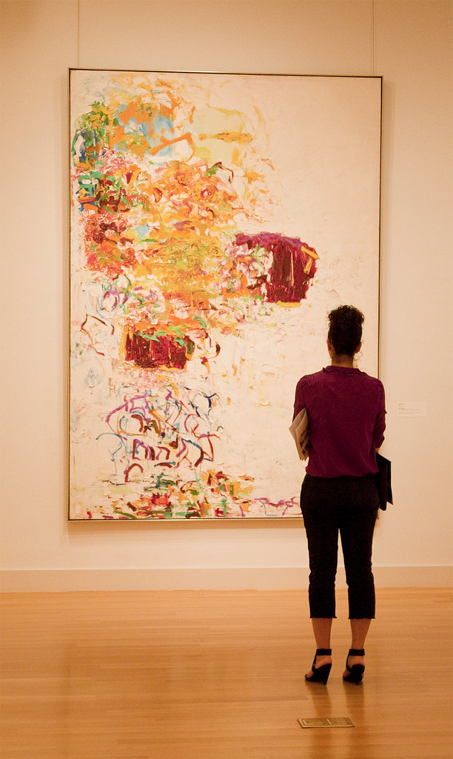
Strategies for Designing a Poster
Think carefully about its visual appeal. Your poster is like a work of art. As the artist, you need to consider how your audience will be engaging with your work and make your design choices accordingly.
Aim for a balance between words and images.
Consider text and image size, especially with respect to distance.
Select an easily readable font (and complimentary fonts…serif and san-serif).
Don’t go wild with color—readability is key.
Print your poster in advance so that you have enough time to revise and re-print if you need to.

Slide 15
Crowdsourcing
Does anyone have any advice they would like to share regarding crafting CFAs/CFPs and posters?

Slide 16
Questions?

Slide 17
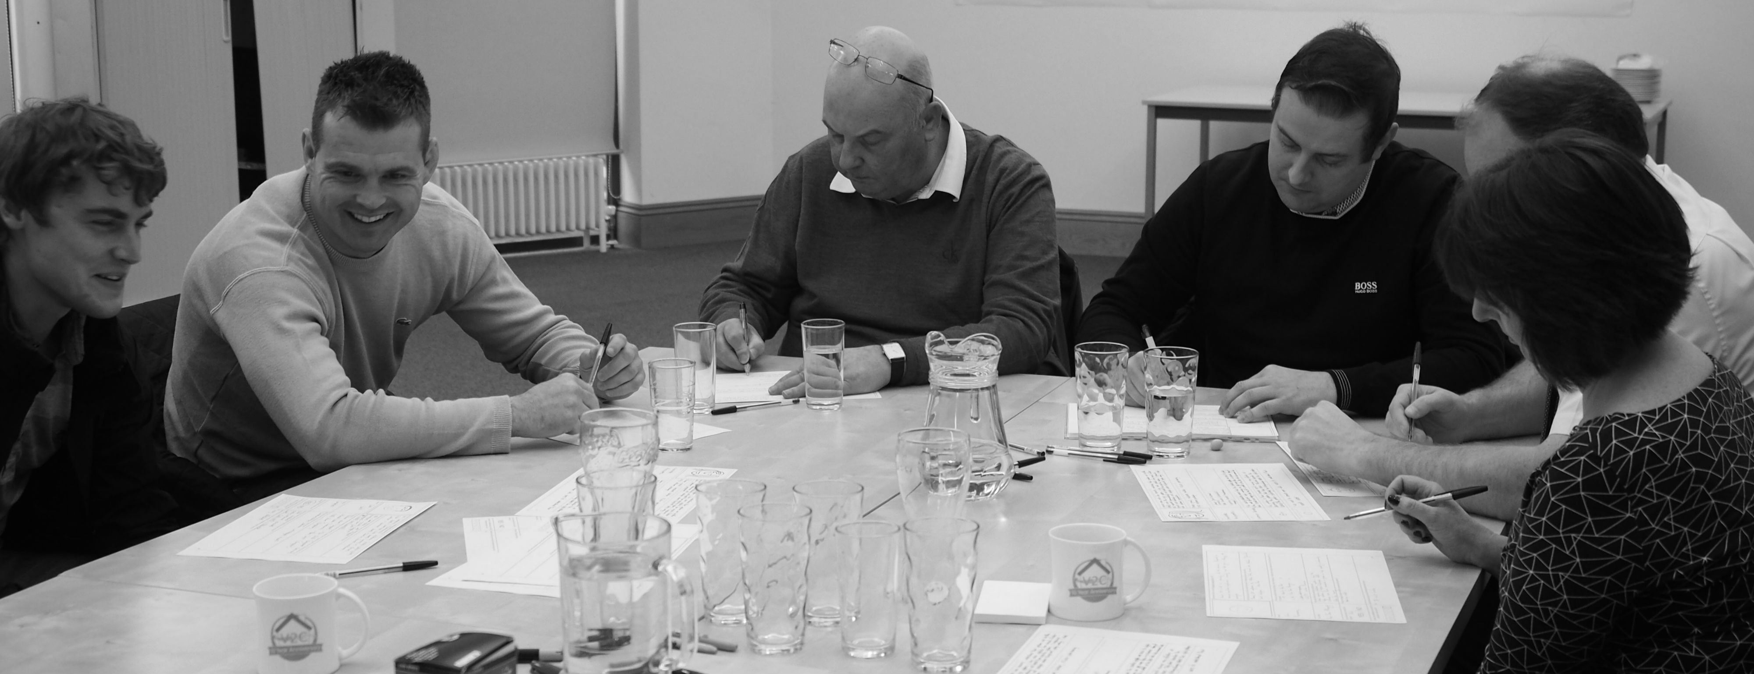
Workshop
Let’s spend the time we have left workshopping our CFAs/CFPs and/or posters.

