Slide 1
Welcome to the Graduate Writing Center (GWC)

Slide 2
Introductions
Dr. Kelsie Endicott, Coordinator of the Graduate Writing Center
Education:
2022 Ed.D. in Contemporary Curriculum Theory and Instruction: Literacy from Salisbury University
Professional Experience:
10+ years tutoring writing
Writing Experiences:
Dissertation
2014 MFA in Creative Writing & Publishing from the University of Baltimore
2010 BFA in Creative Writing from the University of North Carolina Wilmington
3+ years as a writing center administrator
3 years as an English composition instructor
Project Proposal
Comprehensive Exam
Scholarly Journal Article
CV
Resume
Scholarship Applications
Grants
Precis
Literature Review
Essays
Short Stories
Poems
Miscellaneous/Other

Slide 3
GWC Mission & Philosophy
Mission: The GWC will provide writers with the resources and customized writing support they need to assist them with their writing projects and teach writing moves and strategies that will help students better their writing.
Tutoring Philosophy: I believe that writing is a social endeavor and as such, writing is always a collaborative event. Thus, my tutoring philosophy is to collaborate with writers to help them reach their writing goals and to teach writers genre moves and strategies necessary for writing effectively. My goal for writers after using the GWC is that they feel empowered and knowledgeable enough to complete their writing projects independently.

Slide 4
Services
One-on-one Tutoring
Group Tutoring
Creation & Facilitation of Writing Groups
Workshop Presentations

Slide 5
GWC Hours of Operation and Modalities
Writers may make an appointment online using WCOnline: https://wwwcp.umes.edu/grad/graduate-writing-center/
Appointment modality options are: in-person or online synchronous
In-person appointments will meet in the Engineering & Aviation Sciences Complex, Room 3047
Online synchronous appointments will meet through WCOnline
All tutoring sessions will last a maximum of 45 minutes per session
You can make up to 1 appointment per day and 2 appointments per week
Come prepared to your session with the materials you’ll need (e.g. assignment prompt, related readings, piece of writing to be discussed, etc.)
Our fall semester hours of operation are:
Monday: 1 p.m. – 4 p.m.
Tuesday: 9 a.m. – 12 p.m.
Wednesday: 3 p.m. – 7 p.m.
Thursday: 3 p.m. – 6 p.m.
Friday: 11 a.m. – 1 p.m.
Saturday & Sunday: CLOSED

Slide 6
How to Make an Appointment Using WCOnline
Create an account (if you’re a first-time user) on WCOnline https://wwwcp.umes.edu/grad/graduate-writing-center/
Log in using your account credentials
Choose your preferred date and time by selecting the available consultants that day
Once you’ve selected a date and time, you will be prompted to complete a short in-take form where you will provide information as to the type of assignment you want to work on during the session and concerns you’d like to address
Once you complete this form, your appointment is all set!
*Note:
-You may cancel your appointment at any time
-If you arrive more than 15 minutes late to your session, it can be marked as “missed”
-If you miss 3 of your appointments, your account will be locked and you’ll need to speak with me to unlock it

Slide 7
Create an Account
Take a few minutes to register for an account.
https://umes.mywconline.net/

Slide 8
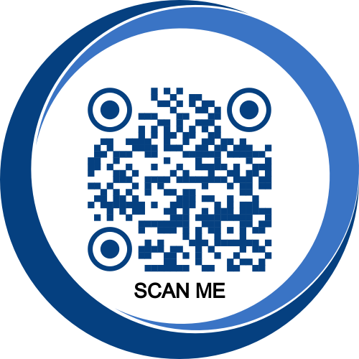
Coming Up
Keep an eye out for upcoming workshops. Our next workshop is virtual and is on Wednesday, September 27th at 6 pm. The topic is an introduction to academic writing.
Also, our bi-annual GradHawks Writing Retreat will be happening Friday, October 6th-Saturday, October 7th! More information to follow soon.
I’m always looking for participants for mine and Dr. Elangwe’s study UMES’ GWC. If you are interested, please scan the QR code.

Slide 9
Examples of Plagiarism
Turning in someone else's work as your own.
Copying large pieces of text from a source without citing that source.
Taking passages from multiple sources, piecing them together, and turning in the work as your own.
Copying from a source but changing a few words and phrases to disguise plagiarism.
Paraphrasing from a number of different sources without citing those sources.
Turning in work that you did for another class without getting your professor's permission first.
Buying an essay or paper and turning it in as your own work.
It is possible to cite sources but still plagiarize. Here are some examples:
Mentioning an author or source within your paper without including a full citation in your bibliography.
Citing a source with inaccurate information, making it impossible to find that source.
Using a direct quote from a source, citing that source, but failing to put quotation marks around the copied text.
Paraphrasing from multiple cited sources without including any original work.
Patchwriting (like paraphrasing, but still using the majority of a source’s words without quoting them)

Slide 10
Resources for Understanding Plagiarism
Information on identifying and avoiding plagiarism can be found here:
https://resources.library.lemoyne.edu/guides/academicintegrity/example-plagiarism#:~:text=Here%20are%20some%20examples%20of,the%20work%20as%20your%20own.
https://owl.purdue.edu/owl/avoiding_plagiarism/index.html
https://apastyle.apa.org/products/publication-manual-7th-edition
https://apastyle.apa.org/instructional-aids/avoiding-plagiarism.pdf

Slide 11
Questions?

Slide 12
Resources & Contact Information
Graduate Writing Center: https://wwwcp.umes.edu/grad/graduate-writing-center/
WCOnline: https://umes.mywconline.net/
School of Graduate Studies: https://wwwcp.umes.edu/grad/
Graduate School Guide to the Preparation of Theses and Dissertations: https://wwwcp.umes.edu/grad/catalogs-handbooks/
Dr. LaKeisha Harris: llharris@umes.edu; (410)-651-7966
Dr. Wele Elangwe: welangwe@umes.edu; (410)-651-8626
Dr. Kelsie Endicott: kjendicott@umes.edu; (410)-651-2971

