Slide 1
Strategies for Writing a literature review
Dr. Kelsie Endicott

Slide 2
Overview
Define literature review
Discuss its purpose and features
Researching strategies
Discuss how to write a literature review
Review a rhetorical reading guide (RRG) of a lit review
Grouping & synthesis activity
Questions

Slide 3
What is a literature review?
A literature review is a discussion of the relevant (scholarly) literature on your topic of study.
For example, if I’m studying how professors and students interact with feedback on writing, then I might want to consider the following areas of scholarly literature on the topic:
Feedback in higher education
Feedback as a form of assessment
Feedback styles/types
Professors’ feedback styles and modalities
Professors’ perceptions of providing feedback to students
Students’ perceptions of feedback
Peer review

Slide 4
Purpose of a literature review
Give readers the context they need to understand your research project
Demonstrate your knowledge on the topic to prove your credibility as a researcher
Show readers how your study is in communication with, or situated with relevant scholarship on your research topic
Note: Your study should be additive in nature, meaning that it adds to the growing body of knowledge on your subject of study.

Slide 5
Strategies for gathering literature
Keep a log of your keywords.
Use a citation management tool such as Zotero, Mendeley, Endnote.
Start searching in Google Scholar.
Use your library’s online databases, such as ERIC, Ebscohost, JSTOR, etc.
Just read the abstracts of scholarly journal articles before committing to reading the entire article. Doing so will help you quickly find articles that are most relevant to your research.
Once you find a good source, read the references—you may be able to find more useful sources from them.
Take notes on your sources. Highlighting is okay, but making notations will do a better job of helping you remember why you liked what you did about scholarly journal articles. If you don’t want to take notes in the margins, write yourself a brief summary of the article including why you liked it and how it will be useful.

Slide 6
Writing Moves to make when writing a literature review
Always consider your audience!
Determine the areas of scholarship related to your topic that you will need to discuss.
Use headings and sub-headings in your review.
Literature reviews are both an informative and persuasive genre of academic writing.
Synthesize the information you’ve gathered and comment on it.
Organize your literature review by theme or chronology.

Slide 7
Writing Moves to make when writing a literature review: Audience
Always consider your audience! Who is your audience? What will readers expect you to discuss during your literature review? Try to anticipate their expectations.

Slide 8
Writing Moves to make when writing a literature review: Strands of literature
Determine what areas of scholarship related to your topic that you will need to discuss. These areas will be your strands of literature that you will eventually weave together as you write your literature review.

Slide 9
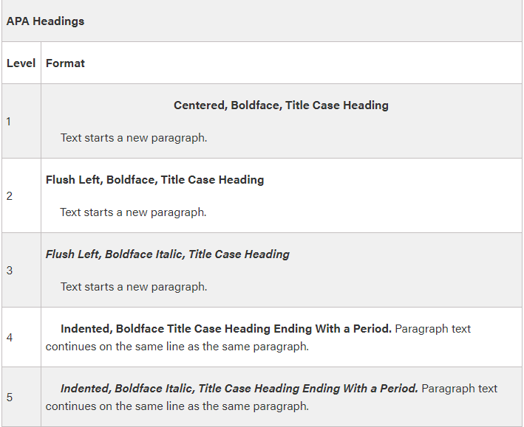
Writing Moves to make when writing a literature review: Headings
Use headings and sub-headings in your review. These help readers to easily see the strands of literature you’ll be discussing AND they act as natural transitions from strand to strand.

Slide 10
Writing Moves to make when writing a literature review: Genre
Literature reviews are both an informative and persuasive genre of academic writing.
Informative
Tell/convey information
Make observations and identify them
Persuasive
Build your argument in a way that you think is more convincing
Arrange and present your scholarship so as to be convincing
Explain and discuss quotes/quoted material
Paraphrase
Use persuasive language (“suggest,” “recommend,” “argue”)

Slide 11
Writing Moves to make when writing a literature review: synthesize
Synthesize the information you’ve gathered and comment on it.
Synthesis: the composition or combination of parts or elements so as to form a whole
Imagine that you are having a dinner party. You as the researcher/writer are the host, and your guests are the relevant scholarship you’ve read on your topic of study. As the host of the “party”, its your job to introduce your guests to each other and put them in conversation with one another. Since you’re the host (researcher/writer), you already know what your guests (scholars) beliefs and opinions are on these related topics/strands, and so it’s your job (as the host/researcher/writer) to put them in conversation with one another. How would their thoughts on the subject “sit with” other scholars in the room?
Other metaphors might involve you being a DJ and the songs being the scholarship, of you could be the host of a talk show, and the guests are the scholarship you read on the topic, but I hope you get the point.

Slide 12
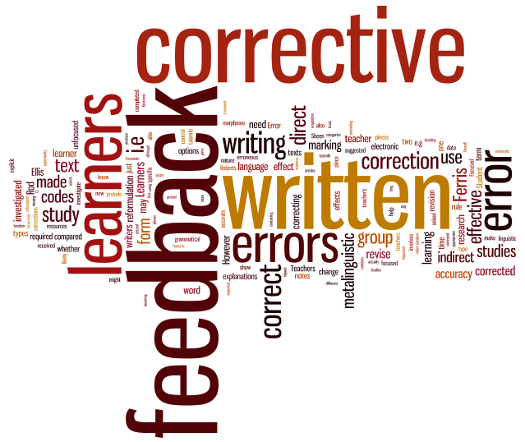
Writing Moves to make when writing a literature review: Organization
Organize your literature review by theme or chronology (if it’s a longer lit review, it’s possible to do both).

Slide 13
Example from an abbreviated literature review
The complete document (RRG Lit Review) can be found on the GWC’s website under the tab “General Writing Resources”
https://wwwcp.umes.edu/grad/writing-resources/

Slide 14
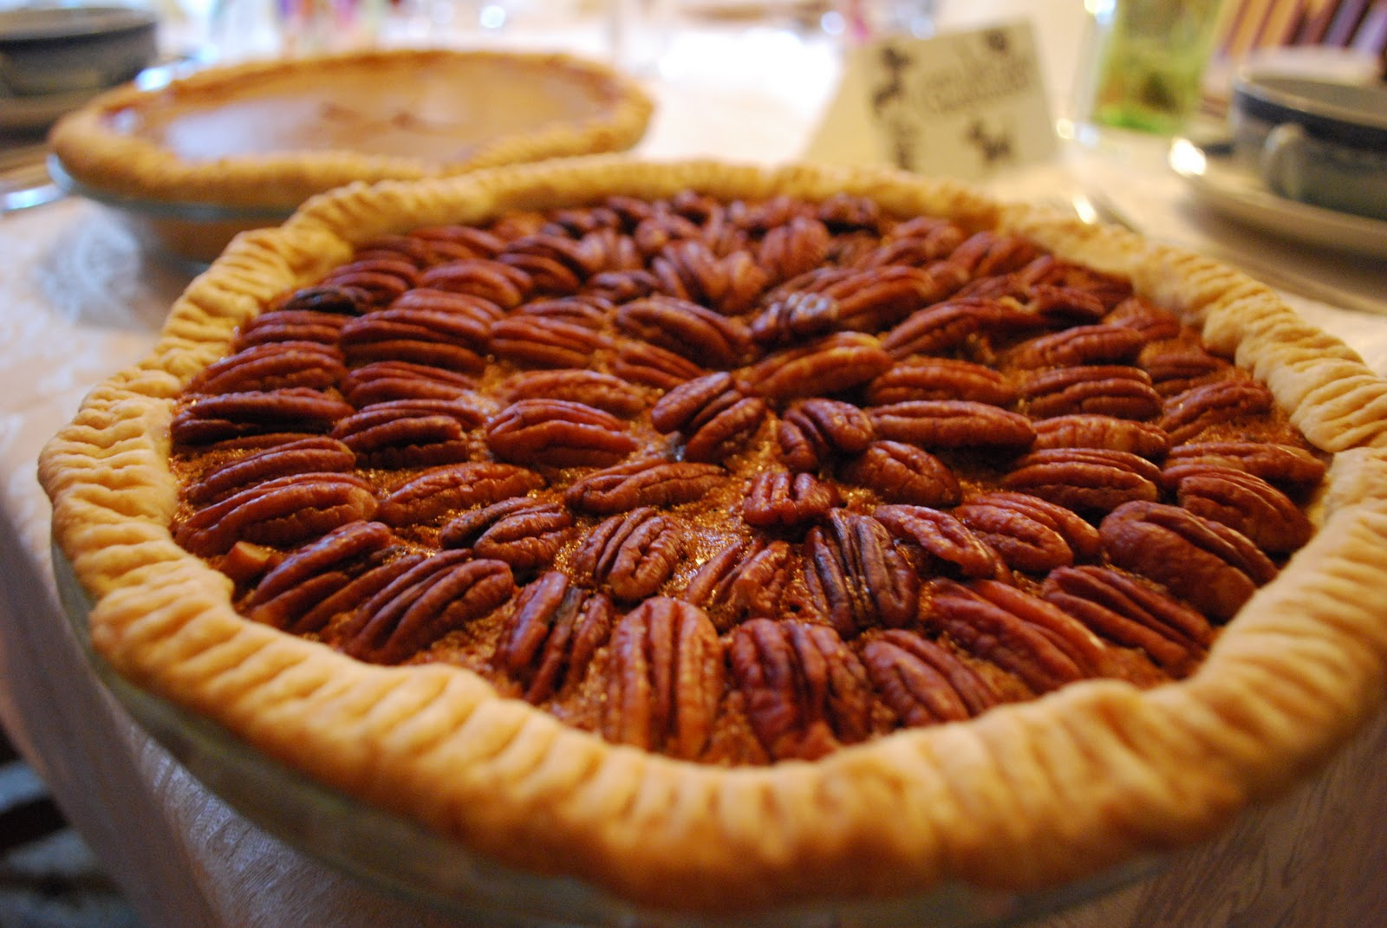
Grouping and synthesis activity
Please develop categories and group the sweets into your categories. Be ready to explain your groupings.

Slide 15
Questions?
Dr. Kelsie Endicott, kjendicott@umes.edu
Graduate Writing Center: https://wwwcp.umes.edu/grad/graduate-writing-center/

