Slide 1
Conquering the Thesis or Dissertation Process
UMES Graduate School Workshop
Wele Elangwe, Ph.D.
Director of graduate student services

Slide 2
Agenda
Help me…
Designing
Format and Structure
Citing Sources
Resources
Final Thoughts

Slide 3
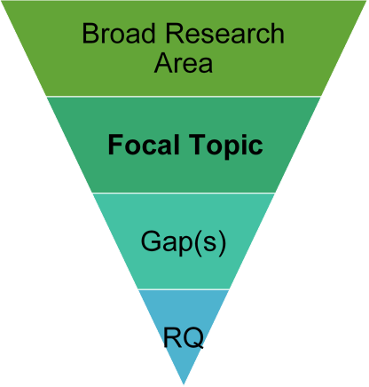
Help Me…
Identify Broad Research
Focus
Examine the literature
Identify areas of exploration
Identify the Gap(s) in the Literature
Is this a gap worthy of exploring?
Will studying this help contribute to furthering knowledge in your field?
Create Your Research Question(s)
What questions will help to address the identified gap in the literature?
What methodological approach is appropriate?

Slide 4
Goals of research
Goal of Research | Description | Abstract Question
Exploratory Research | Seeking to determine if a phenomenon exists | Does it exist?
Descriptive Research | Differentiating phenomenon from other phenomenon or attempting to characterize it in a more complete manner | What are its characteristics?
Predictive Research | Identifying relationships to provide knowledge about some thing by knowing about another thing | To what is it related?
Explanatory Research | Seeking an explanation by examining a cause-effect relationship between two or more phenomena | What causes it?
Action Research | Research to solve a social problem | Can this be used to solve a problem?

Slide 5
Cyclical Nature of Research
Review of
Literature
Topic
Creation of
Selection
Operational
Definitions
Curiosity
Publication or
Hypothesis
Dissemination
Formulation
Explanation
Data
of Results
Collection
Dane,
(
2011)

Slide 6
Designing Your Study
Having Research Mindset
Literature guides your study
YOU ARE NOT PROVING ANYTHING!
The hypothesis is supported or not supported
Be cautious and conscientious with words
Hypotheses (quantitative) must support research questions
Synthesizing questions (qualitative) must support research questions

Slide 7
Methodological Thinking
Deductive Logic (usually quantitative studies)
Using what is already known to determine what data to collect and what it will mean (Predictable)
Inductive Logic (usually qualitative)
Using data to develop concepts and theories (Emergent. Lens. No predictability)
Hypotheses must come from existing literature – deductive logic
If limited knowledge on a topic, study primarily utilizes inductive logic
Many studies utilize a combination of both types of logic

Slide 8
Format and Structure
Follow the guidance provided by UMES
Follow the guidance provided by your specific department and advisor

Slide 9
General
Chapter 1
Introduction to the Study or
Statement of the Problem
Review of the Literature Theoretical or Conceptual Framework
Chapter 2
Methodology of the Study
*Ethical Practices – IRB Protocols *Sample, data collection, analysis, R & V
Chapter 3
Chapter 4
Results of the Study (quantitative)
Findings of the Study (qualitative)
Chapter 5
Discussion and
Conclusions
(
UMES theses and dissertation guide,
2015
-
2016)

Slide 10
Format and Structure - ORLD
Chapter 1
Introduction
Chapter 2
Literature Review
Chapter 3
Theoretical Framework (quantitative)
Conceptual Framework (qualitative)
Chapter 4
Research Design and Methodology
Chapter 5
Results of the Study (quantitative)
Findings of the Study (qualitative)
Chapter 6
Discussion and Conclusions

Slide 11
Chapter 3 - (ORLD students ONLY) (Theoretical or Conceptual Framework)
ORLD utilizes a distinct chapter for the theoretical/conceptual framework
Overview of chapter
Theory(ies) or concepts from which study is derived
How does theory inform this study?
What is missing from theory that this study may help to explain?
Conceptual or theoretical model of the study
Research questions
Hypotheses or synthesizing questions
Summary of the chapter

Slide 12
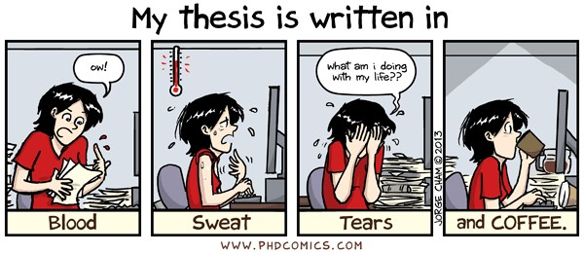
Final Pieces
References
Appendices

Slide 13
Format and Structure
Utilize UMES guidelines
Citation and reference format dictated by your program
APA common in social sciences
(American Psychological Association, 2022)
Publishing on ProQuest

Slide 14
resources
Department
Chair
Advisor
Professors with specific expertise
Department formatting guidelines
UMES Guide to Preparation of Theses and Dissertations
UMES Graduate Writing Center***
Peer mentors
Books & articles

Slide 15
Final Thoughts
Prior research informs your study
Be flexible
Remain open to other options
Listen to feedback
Cite your sources
You must be passionate about the topic
IT WILL NOT BE PERFECT

Slide 16
References
American Psychological Association. (2020). Publication manual of the American Psychological Association (7th Edition). APA.
Brewerton, P., & Millward, L. (2004). Organizational research methods: A guide for students and researchers. Thousand Oaks, CA: Sage Publications, Inc.
Dane, F. C. (2011). Evaluating research: Methodology for people who need to read research. Los Angeles, CA: Sage Publications, Inc.
Daniel, J. (2012). Sampling essentials: Practical guidelines for making sampling choices. Thousand Oaks, CA: SAGE Publications, Inc.
Fowler, F. J. (2014), Survey research methods. Los Angeles, CA: Sage Publications, Inc.
Loseke, D. R. (2017). Methodological thinking: Basic principles of social research design. Thousand Oaks, CA: Sage Publications, Inc.
Machi, L. A., & McEvoy, B. T. (2016). The literature review: Six steps to success. Thousand Oaks, CA: Corwin.
Morgan, S. E., Reichert, T., & Harrison, T. R. (2017). From numbers to words: Reporting statistical results for the social sciences. New York, NY: Routledge.
Pollock, T. G., & Bono, J. E. (2013). Being Scheherazade: The importance of storytelling in academic writing. Academy of Management Journal, 56(3), 629 – 234. doi: 10.5465/amj.2013.4003

