Slide 1




UMES Middle States Self-Study Update
-
01
December 12, 2023
02

Slide 2
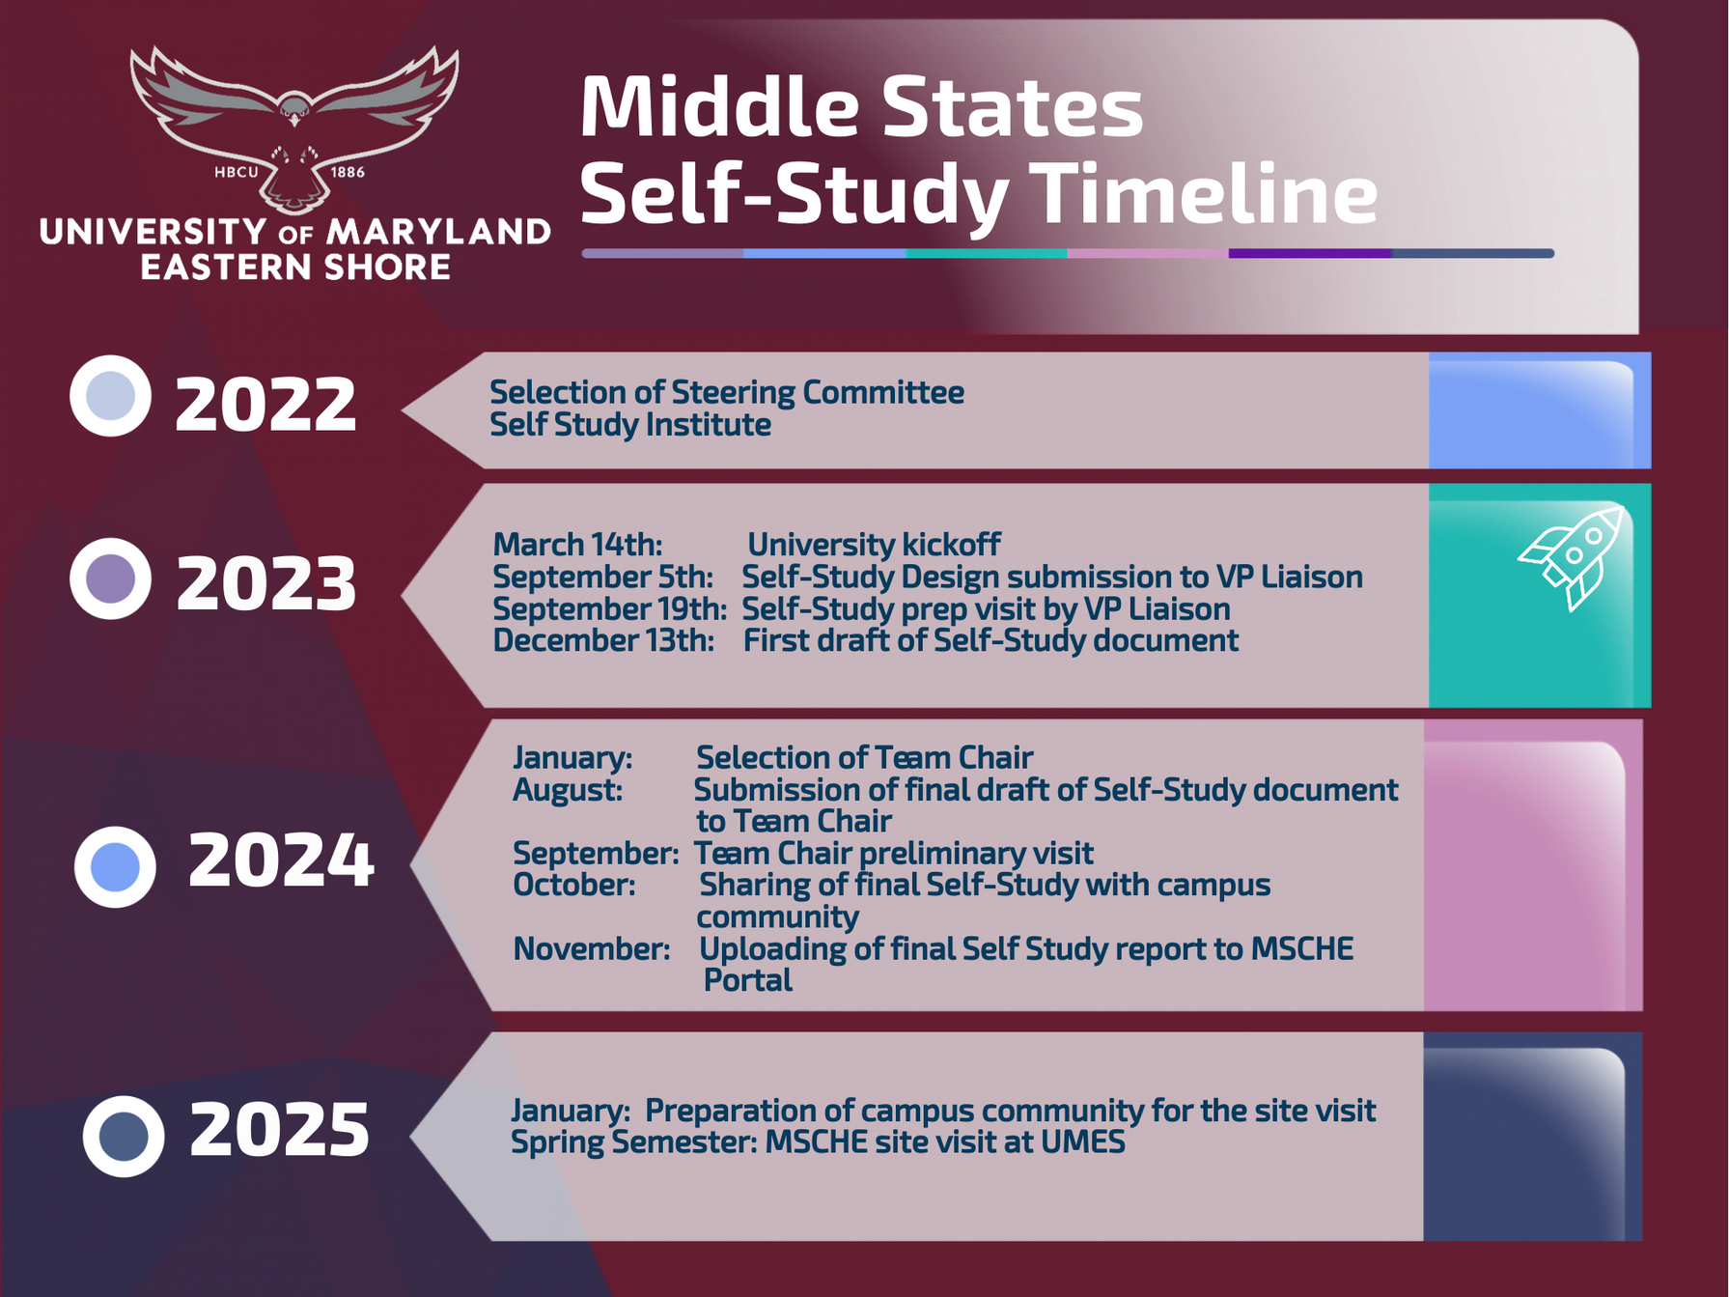

Slide 3




Key Timeline Milestones
  Self Study Design
    Campus visit by MSCHE Vice President Liaison Peavy occurred on September 19th, 2023.
    The UMES Self Study Design was accepted by MSCHE on October 6, 2023.
  Self-Study Report
    Working groups are working on their assigned Standards.
    First draft - December 18th, 2023
  Selection of Team Chair - January 2024.
  Site visit - Spring 2025
01
02
03

Slide 4

Accreditation Software
Modules
Accreditation Management
Assessment Management
Faculty Credentials Management
Program Review
Strategic Plan Tracking
01
02
03

Slide 5
Self-Study Information
https://wwwcp.umes.edu/middlestates/
14
15
-

