Slide 1
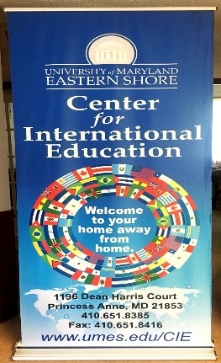
Faculty Abroad Opportunities
‘To Promote Understanding of Cultures, Professional Development
and Personal Enrichment.’

Slide 2
UMES Study Abroad Afilliates
KEI
ISA
SAI
Institute of International Education
https://www.iie.org/en/Programs
The Penn Center for Minority Serving Institutes
http://www2.gse.upenn.edu/cmsi/opportunities/frederick-douglass-global-fellowship
AACU
https://www.aacu.org/resources/global-learning
CIEE
https://www.ciee.org/go-abroad/educators/international-faculty-development-seminars/seminars
Peace Corps Prep Program
Planned Fall 2017 launch
Planned implementation Spring 2018
https://www.umes.edu/CIE/

Slide 3
Programs | KEI | ISA | SAI | Details per SAI website
Faculty Fellow | Not Offered | Not Offered | This program offers faculty the opportunity to broaden their teaching and scholarship activities through a funded month in Italy | Purpose: To foster a deeper connection between faculty and Italian institutions and To provide opportunities to faculty for continuing their research and studies The award includes international air travel, and one bedroom apartment accommodation for one month in Florence or Rome.( additional charge for friends and families) Faculty (all disciplines) from SAI affiliate colleges and universities are invited to apply for the 2018 – 2019 Faculty Fellows Program in Florence or Rome. The fellowship can be arranged during any of the following periods: June 1 – July 31, 2018 or October 1 – November 30, 2018 or February 1 – March 31, 2019.

Slide 4
*Faculty Led (integrated) | Offered | Not Offered | Not Offered
**Faculty Led (Custom) | Offered | Offered | Offered | Details per SAI website
Staff Development Grant | Not Offered | Not Offered | This program, open to study abroad staff of affiliated institutions, offers staff the opportunity to broaden their professional experience with a funded period at one of the following SAI sites: Barcelona, London, Milan or Paris. | Purpose: To foster a deeper understanding of an SAI program location. To enhance the connection between study abroad staff from affiliate institutions and SAI on-site staff, as well as working together on International projects SAI will cover the cost of in-country accommodation and will provide two daily meals (breakfast/lunch), Ground transportation. Remaining costs are the responsibility of the university/staff member. Colleagues from our affiliate colleges and universities are invited to apply for the 2017-2018 SAI Staff Development Grant. Grants are available for the fall and spring semester, and activity should occur between the following dates: October 1 – December 1, 2017, or between February 1 – May 1, 2018.
*Faculty Led (integrated): Integrated programs combine students and faculty from the home institution in the USA with faculty and students from a host institution abroad.
**Faculty Led (custom): Customized programs are group arrangements that are supervised by faculty from the home institution.

