Slide 1
Center for Instructional Technology and Online Learning
Center for Instructional Technology and Online Learning
All the projects we are working on right now.

Slide 2
Blackboard Usage
Total Courses Offered – 1144
Undergraduate – 923
Graduate – 221
Active Blackboard courses – 822
72% active usage

Slide 3
Online & Hybrid Classes
105 Online Classes
37 Hybrid Classes
Classes that are online/hybrid but are designated as face-to-face - ???

Slide 4
What does MHEC say?
The issue of institutional integrity is at the core
Students have the right to know the nature of the course prior to enrollment
…inappropriate to have students enroll with the expectation of a particular delivery method and then change the mode of the course
... Do not have the option [to change modes] … post enrollment
… accusations of fraudulently enrolling students
NC-SARA complaints

Slide 5
Standardization of Online & Hybrid Classes
We are now associated with NC-SARA
48 states and DC
Courses are acceptable across state lines.
More rigorous standards for our online classes.
Internal review process using the QM Rubric

Slide 6
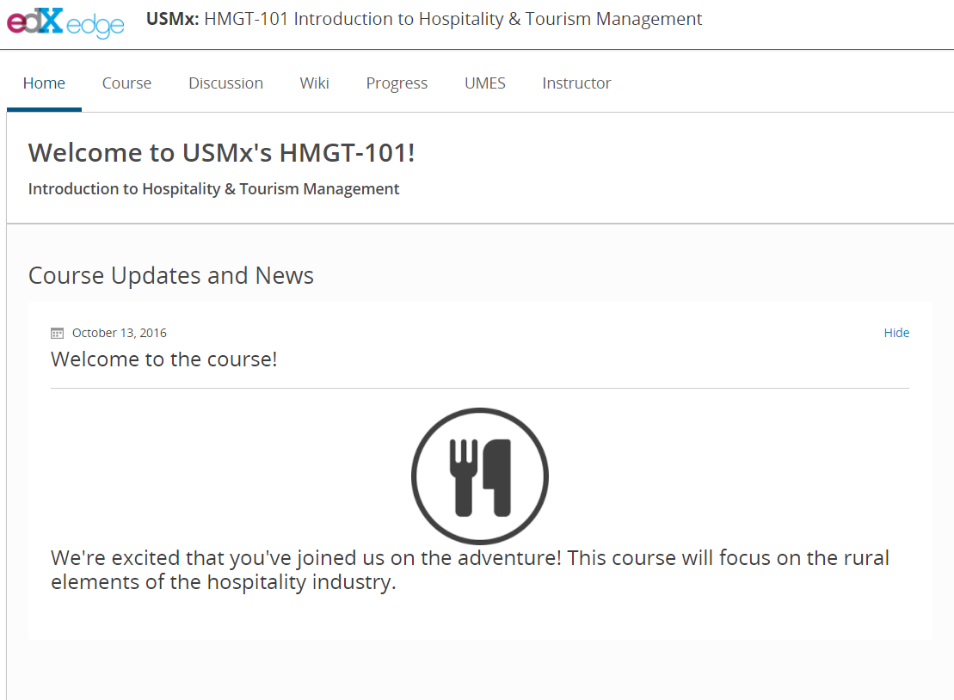
edX Course – HMGT101
Introduction to Hospitality and Tourism Management
Being reviewed by the instructor
Next week – meet with course designers
Launch by the end of the semester

Slide 7
Open Educational Resources
Our goals
Reduce costs
Use the most current resources
Tailor resources to our students’ needs
We will be working with faculty to develop OER for the departments.

