Slide 1

Enabling Growth
* Financial Edification
*Facility and IT Infrastructure Planning - short term
*Redesign Personnel Management
*Classroom and Course scheduling management
*Expand Revenue Contracting
*Physician Assistant Program
*Reward new sustainable efficiencies and revenue concepts
*Create a 501c3 to support creative revenue ideas for community partnerships
*Athletic Team Expansion
*Early Retirement Program Incentives
*Wages equity Plan Phase I
*Pharmacy Building Phase I
*AgREC Building
*Athletic facilities renovation Phase I
*Expand on-line programming at Grad level
*Create Program breakeven policy
*Engage “back room” service collaborations within USMs for greater efficiencies
*Implement ERP systems that increases automation and reporting
*Create contingency staff level plan to address revenue fluctuations
Problems can become opportunities when the right people come together.
2023
2022
*Engage outside firm to develop a facility infrastructure assessment and space management planning.
*Study and continue to expand or eliminate academic programs and research, for new and relevant degrees
Pharmacy Building Phase II
2021
2020

Slide 2





RISE
Renewing Integrated System Enterprises
Moving our ERP system to the cloud at UMD and UMES.

Slide 3


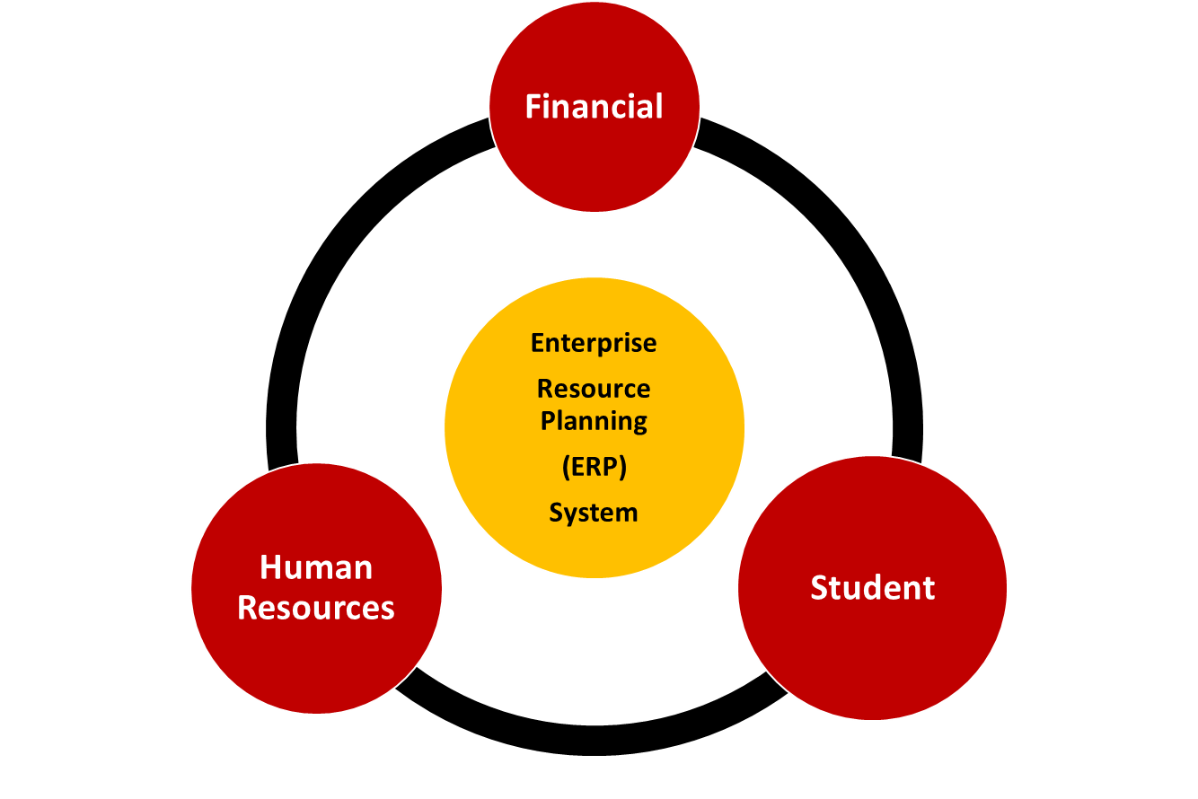
Why Elevate/RISE?
Our obsolete ERP system can no longer meet the complex needs of a flagship research university.
Notes:
Elements of the current ERP do not speak to one another and as a results data differs across these systems (creating data errors).
Staff waste time logging into multiple systems and re-entering data.
Systems pose security risks.
Elevate will modernize our ERP using a single cloud-based platform.

Slide 4


Goals of the Elevate/RISE Project
Provide a positive user experience for students, staff, and faculty.
Make the university more efficient and effective through simplified and streamlined business processes. One system, not three
Allow the university to accurately collect, report, and analyze data.
Ensure data security and privacy.
Ensure that our ERP systems are reliable, can be easily maintained and regularly updated. Moving to the cloud.

Slide 5




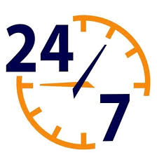

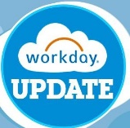





RISE will transform the way we do business.
Single Data Source
Single Login
No down time.
Mobile
Elevate/RISE
Regular Updates
Information Sharing
Dynamic Reporting
Simplified Training
Enhanced
Security
Streamlined Integrations

Slide 6

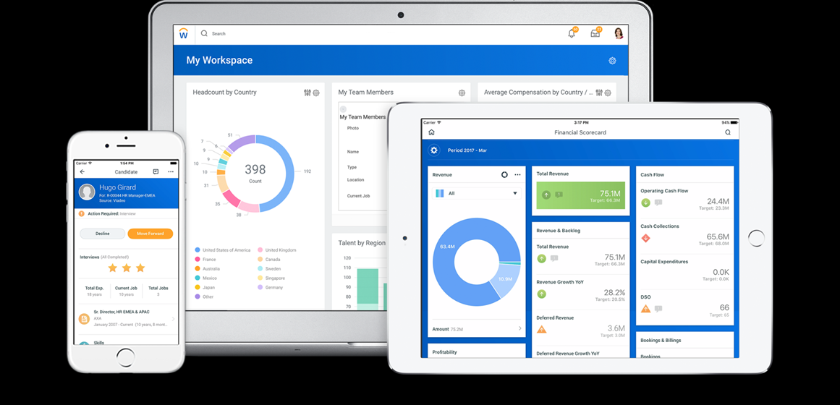
Elevating our ERP to the cloud with Workday.
Notes:
Modern cloud-based software that will provide a positive user experience
More efficient and effective
Minimizes risk
Data-driven decisions
Easier maintenance and upgrades
Efficiently meet regulatory, compliance and accreditation needs

Slide 7











We are in good company.
Notes:
Other Universities are migrating to Workday.

Slide 8
How will we implement the new system?

Slide 9




Implementation is a Partnership
*
*Note – Huron has been selected for negotiations.

Slide 10
When will this happen?

Slide 11
Review of UMD systems and cloud-solution options in higher ed.
Request for Proposals:
Platform
Implementation Partner
Review process:
Platform
Implementation Partner
Final Selections
Contract negotiations.
Sept-Dec 2020:
Contract Approvals from
Board of Regents
Board of Public Works
2017 - 2020
2021
2022
2023
2024
2025
2026

Slide 12


Slide 13
Who is involved in RISE?

Slide 14
Who is involved in RISE at UMES?
Mr. Lester Primus, Executive Sponsor
VP for Admin and Finance
Dr. Nancy Niemi, Executive Sponsor
Provost
Mr. Jerry Waldron
Project Lead
CIO
Gertrude Hairston and HR Team
Bonita Byrd and Finance Team
Lachanda Snead and Admin Computing Team
Enrollment Management and Student Engagement

Slide 15
Reach out to us with questions, concerns, ideas
jwaldron@umes.edu
Elevate Website: elevate.umd.edu
Thank you for your investment and engagement today

